Slide 1

NYSED and GED Testing Service: Question and Answer Session
Administering the GED®Test in NYS
January 25, 2022

Slide 2
NYSED HSE Office: http://www.acces.nysed.gov/hse/high-school-equivalency-hse
GEDTS: http://www.ged.com
Please continue to review the power point presentations and documents posted on the NYSED HSE Office Announcements page, the HSE Office website (under HSE Exam) and the GED website. See above. Many of the questions submitted are addressed in the ppts. Thank you.
Introductory comments and overview of today’s session.
Additionally, there will be information sessions over the next few weeks for:
NYSED Test centers - Accommodations; NYSED HSE Coordinator and Examiner (Annual Renewal Training); and any other issues and questions that still need clarification
NYSED AEPP funded preparation programs - Informational sessions will be provided through the RAENs in coordination with GEDTS
NYSED - Moving toward goal of enhanced CBT for NYS GED Test Centers
Posted on 1/19/22: Expanded High School Equivalency Testing Options to Be Available in 2022 and Beyond
Review of the roles and titles of test center staff – Addressed in ppt presentations.
See HSE Website: HSE Test Center Coordinators and Examiners at http://www.acces.nysed.gov/hse/hse-test-center-coordinators-and-examiners

Slide 3
How to Become a GED Test Center: High Level Overview
Test center initiates process by completing a brief online application found here – “Fill out an Application”: https://bit.ly/3qq4dkh
Review & sign test center agreement and submit required photos
Install Pearson VUE testing software
Test administrators/examiners take Pearson VUE Proctor Certification Exam.
Test Center is activated for testing

Slide 4
Security Kit
Security kit – all test centers must purchase a security kit which consists of 2 digital cameras and digital signature pad.
  Security kits can be purchased via Pearson VUE or elsewhere as long as test center purchases specific model of camera/pad. Model #s available in Technology Requirements document.
  Cost of security kit is $450 if purchased via Pearson VUE (one time cost).

Slide 5
How Centers Will Set Their GED Test Schedule
Test centers will use the Pearson VUE system called Site Manager to set their available testing days/hours
Students scheduling their GED tests at ged.com will see each center’s schedule and can choose accordingly
Pearson VUE test software handles the scheduling logistics, e.g. a student scheduling a 2 hour math test won’t be able to schedule the test starting at 3pm if the test center closes at 4 pm or if a student is allowed extra time based on an accommodation this is all handled by the scheduling system.

Slide 6
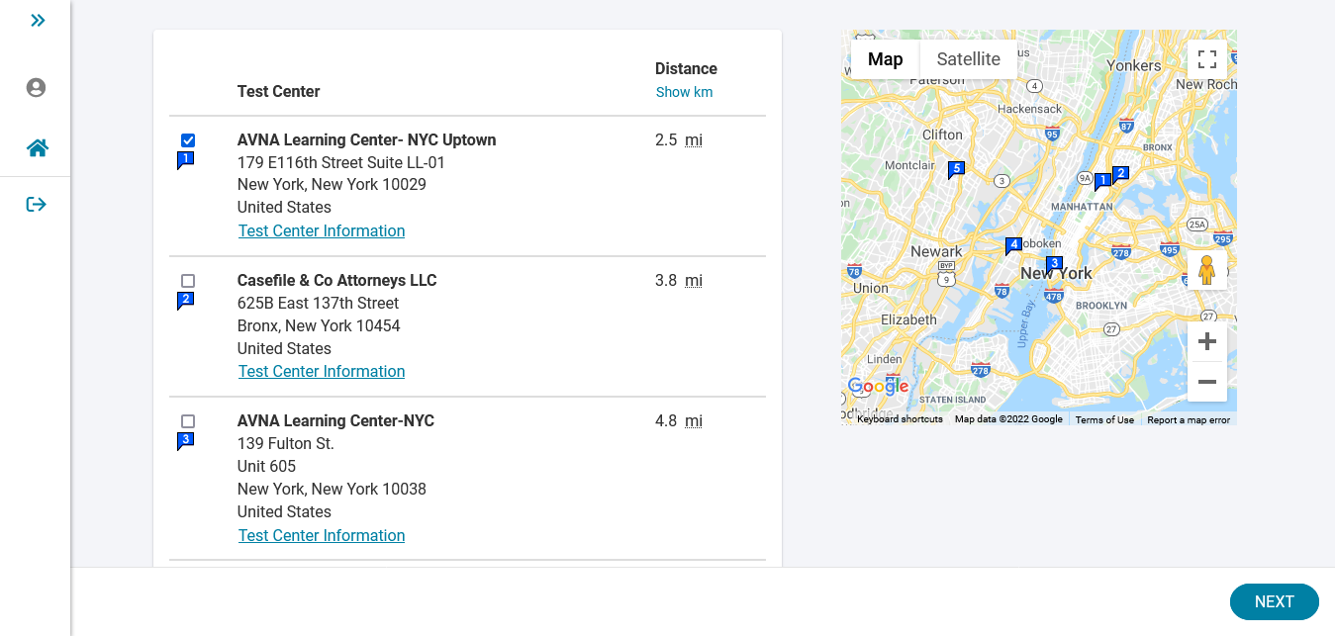
Scheduling Flow

Slide 7
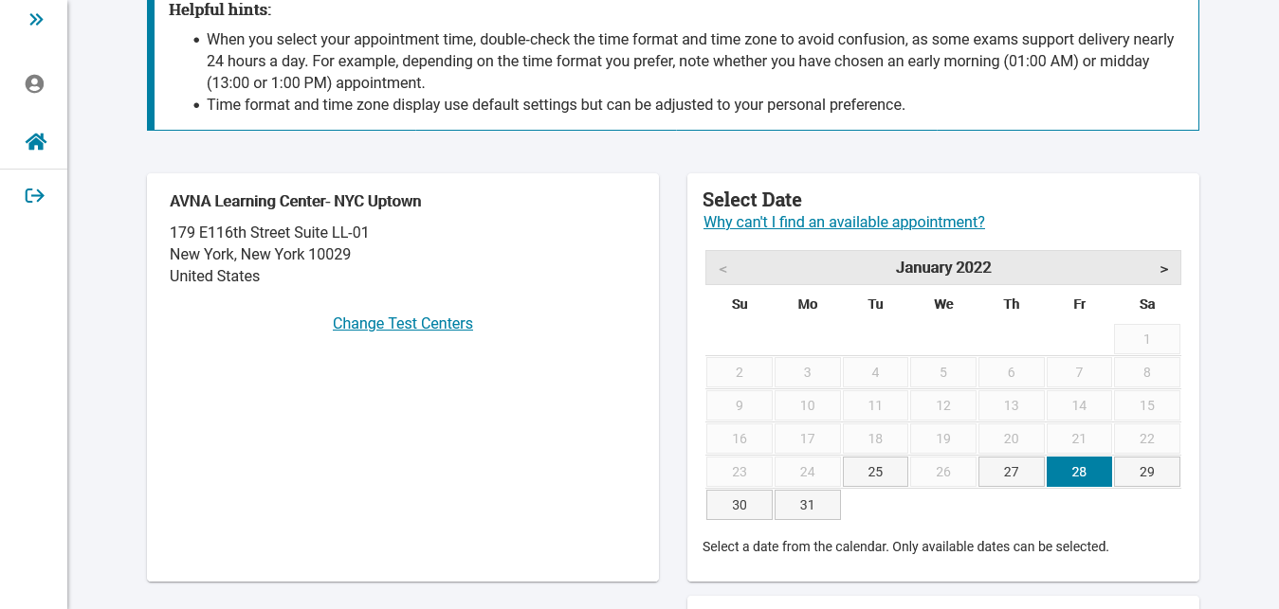
Scheduling Flow

Slide 8
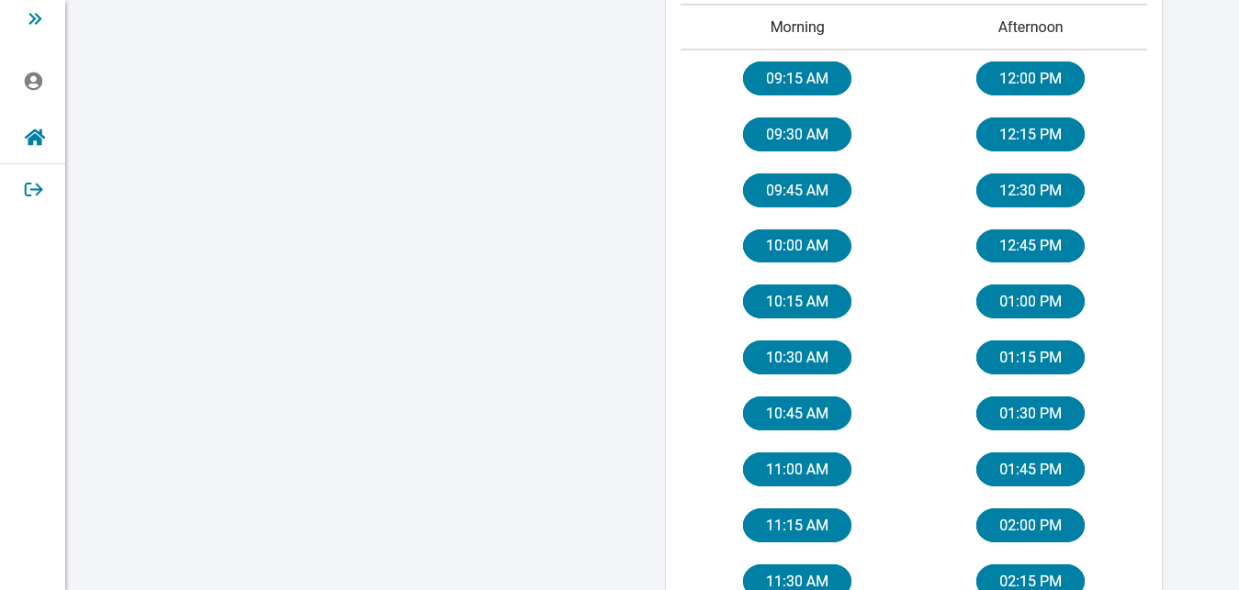
Scheduling Flow

Slide 9
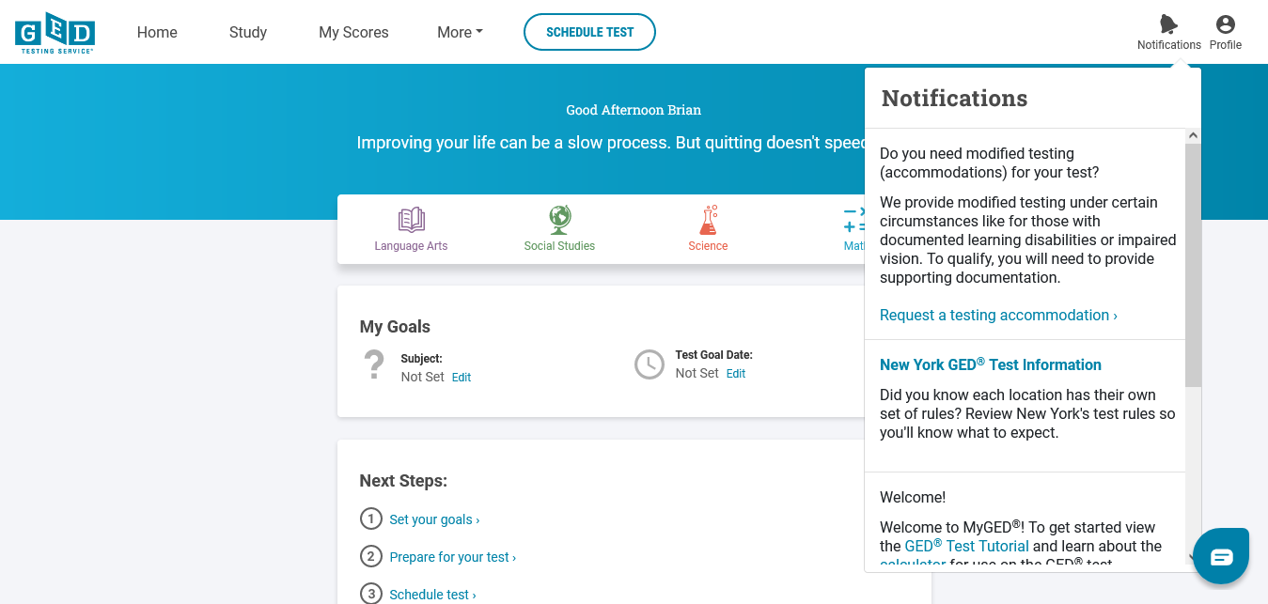
Accommodations

Slide 10
Accommodations
GED.com will take students through the process to request a testing accommodation including uploading necessary paperwork
Students will be notified of a decision within 30 days of them submitting their application/documentation
Our Accommodations Information page
https://ged.com/about_test/accommodations/
We plan to host an All About GED Testing Accommodations webinar in the next month or so.

Slide 11
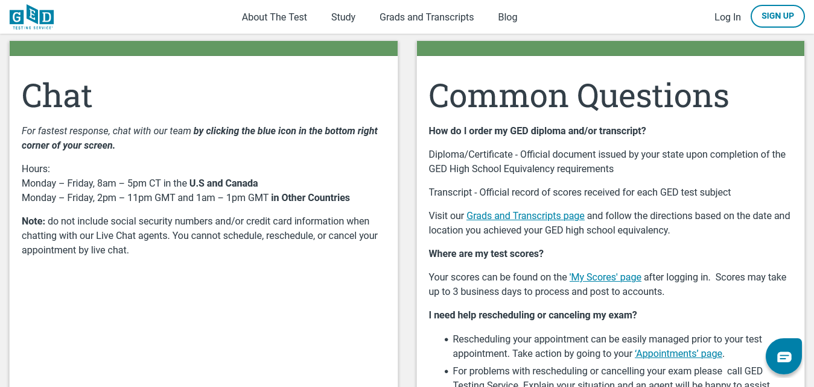
GED Customer Support for Students
https://ged.com/contact_us/
Chat support (recommended)
Phone support
Email

Slide 12
First Steps After Reviewing Webinars
If you are a test center, your first step is to apply to become an authorized Pearson VUE test center per the link shared previously and on GED.com
If you are a correctional facility, your first step is to contact operations@ged.com so we can start the onboarding process.
If you are an educator, your first step is to get familiar with the resources available to you on https://ged.com/educators_admins/program/

Slide 13
Additional Questions for NYSED
Q. Can we administer both CBT and PBT?
A. All public test centers are encouraged to move forward with the process of becoming a GED computer-based test center. As PBT will be approved on a limited basis, test centers can administer the exam to more examinees by offering both. All test centers that are approved for both will go through different approval and training processes and each will be given a unique test center name and number to identify itself in the GED and NYSED HSE systems.
Q. Is PBT the only option for incarcerated moving forward?
A. If incarcerated settings have the permissions and capabilities to offer CBT they are encouraged to move forward with that process. Please email HSETC@nysed.gov if you have questions about this process.
Q. Are we only allowed to use the testing locations previously approved for testing by NYSED?
A. Yes. The process for approving new testing space remains the same. Currently approved test centers should contact HSETC@nysed.gov when you are ready to convey to NYSED that a RAEN’s site visit is needed. As the focus of GEDTS is on the onboarding of existing test centers, no new test centers will be approved for the next several months.
Q. How long will it take for a student to receive their diploma after taking the exam?
A. Official diplomas are mailed to examinees 8-10 weeks from the time of testing.

Slide 14
Additional Questions for NYSED
Q. How will test preparation programs be able to reserve test seats for their participants before it is open to the public?
A. While also meeting requirements for publicly posted availability, test centers are encouraged to work with their affiliated HSE preparation programs to coordinate their exam availability. Test Centers can create new testing availability at any time, this can be timed to align with HSE student readiness.
Q. Will NYSED be providing specific trainings for test examiners and administrators as they have in the past?
A. The HSE Office will be holding additional training sessions and Q&A sessions over the next several months, as test centers continue to have questions about the transition to GED. Please continue to monitor the HSE announcements page.
Q. I have a student whose class doesn't graduate until June 2021. Can I send the Age Eligibility Form in now?
A. Age Eligibility forms should not be completed until the candidate is eligible to test, per the requirements outlined on the age eligibility form. Please view posted ppt presentations which explain age eligibility. A chart is posted on the HSE website which delineates regulations regarding age eligibility: http://www.acces.nysed.gov/hse/taking-hsetasc-tests. Please note that students must be age eligible, based on criteria referenced, when the application is submitted.
Q. I understand that transcripts will no longer be automatically sent when an examinee takes a subject test. Test taker can check their scores in their GED account. Transcripts will be sent when diplomas are awarded. Will an examinee still receive a transcript for the Application R (NYSED Regents-HSE Pathway to an HSE diploma), if they still need to pass additional GED subject test?
A. Yes, official transcripts will continue to be mailed if a test taker submitted an Application R and also earned subtest credit through a GED subject test. Any questions about R applications, or the digital submission process of R applications, can be sent to HSERAPP@nysed.gov.

Slide 15
Additional Questions for NYSED
Q. How is the no show policy enforced? What happens if an examinee had an emergency?
A. No show students – Students who schedule a GED subject test and cannot take it, must cancel through their online account, up until midnight for a test scheduled the next day. Instructions for doing this are outlined when an examinee registers. “No shows” will need to wait 60 days before retesting. Emergencies that occur the day of the test will be resolved, based on supporting documentation. Examinees should reach out to GED customer service if such an emergency occurs.
Q. Can examinees use their own calculators?
A. If students would prefer to use a handheld calculator, instead of the on-screen calculator, they may use the TI-30XS calculator. This is the same calculator that was used previously for the TASC exam.
Q. Do passing TASC subtest scores expire?
A. Grandfathering of TASC and GED scores – Please visit: http://www.acces.nysed.gov/hse/early-access-unofficial-scores. No changes are anticipated.
Q. When will the reimbursement rate change for test centers which receive reimbursement for administering HSE exams?
A. Reimbursement for Administering Exam – Please review ppt on Reimbursement for 2022 and visit HSE website for posted, required forms. Reimbursed sites can use their reimbursement funds towards the purchase of the $450 camera security package. The Reimbursement RFP for 2023 is currently being developed.
Q. How do we enforce COVID restrictions?
It is important that all state and local COVID precautions be followed. Examinees receive a COVID statement when scheduling their exam, advising them to contact the test center directly to confirm all COVID related policies are followed. Test Centers have the option of sending out communications to those examinees that schedule an exam with their test center, as may have been done in the past.
Q. What forms do test center staff have to send to NYSED after the test?
A. Several updated forms are found on http://www.acces.nysed.gov/hse/test-center-forms. The HSE staff will provide instructions on the website, and address in future information sessions. Please continue to use the links for all forms and applications, as forms may be updated. Signature cards are no longer necessary for CBT testing.

