Slide 1

Adult Education Preparation Programs and the GED® Test
Including Candidate Age Eligibility and Use of GED Manager
December 2022

Slide 2
4 Pathways to a High School Equivalency (HSE) Diploma
NYSED HSE Homepage, Announcements, Requesting Duplicate Documents and Status Verification Report:
http://www.acces.nysed.gov/hse/high-school-equivalency-hse
HSE Exam - The GED® Test became the NYS HSE exam in 2022. Previously it had served as the state’s exam from the1940s – 2013. Prior passing HSE subtest scores for the TASC, 2014-2021, and the GED Test, 2002-2013, can be grandfathered toward an HSE diploma.
24 College Credits – Information and Application J
National External Diploma Program (NEDP) - Information for candidates and agencies interested in NEDP.
Regents-HSE Exam - Merging passing Regents scores with HSE testing. Information, includes updated FAQ and Application R
Please always use currently posted forms and applications.
Status Verification Report - Updated link on the HSE home page conveys which subtest(s) are still required to be passed for a candidate to obtain an HSE diploma. Previously “failing transcripts” were printed and mailed to candidates who still needed to take additional subtest(s) to obtain their HSE diploma. This practice was discontinued in 2021.

Slide 3
Public Computer Based Testing (CBT) and GED Manager
Candidates: 1) Create an account at https://GED.com and register for the GED; 2) Indicate in Prep Connect if “Interested” or “Enrolled” in preparation classes. 3) If “yes” is selected, a list of preparation programs located near the candidate are displayed and they should select either the program they are enrolled in or a program they are interested in attending; 4) When ready to test, the candidate schedules needed GED subject test(s) through the online scheduling system which is also accessed through their account; 5)Scores will be available to the candidate in their GED account almost immediately, however, the NYSED HSE Office requires 6-10 weeks to process official results and mail HSE diplomas, if the candidate is successful.
Preparation Programs: The candidate’s name and email address will appear in the preparation program’s GED Manager account as, “Interested,” when the candidate selects the prep program from the choices presented. The candidate must be 19 years of age or have been released from the Age Eligibility queue before they can be viewed in GED Manager. Preparation program staff must change a candidate’s status from “Interested” to “Enrolled” for their 5-digit prep code to be connected to the candidate’s testing. This is essential for preparation programs to receive credit for test taker’s successes, through ASSIST.

Slide 4
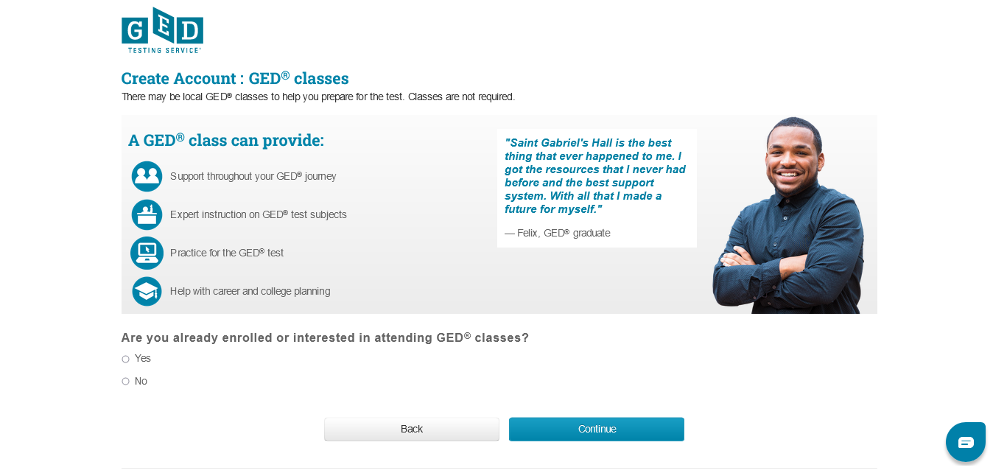
Candidate View When Creating Their GED.com Account

Slide 5
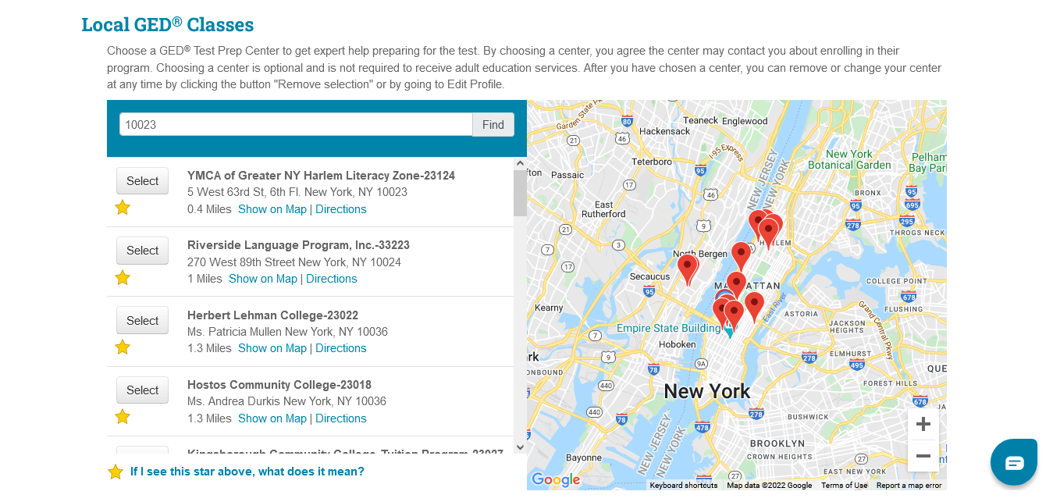
Candidate Routed to Prep Program Selection Page
5

Slide 6
“No Shows”
Candidates who cannot attend their scheduled testing date/time must cancel in their GED account at least 24 hours before the scheduled test or they will be considered a “No Show.”
“No Shows” must wait 60 days before they can reschedule their missed subtest(s) and cannot take the same subtest more than 3 times in a calendar year, if prior tests are failed.
No subtests can be re-taken for a high score if the subtest has already been passed.
NYS has experienced a high “No Show” rate with candidates registering and scheduling subtest(s) but then not showing up to test and not canceling their subtest(s) at least 24 hours ahead of time.

Slide 7
Maximum Compulsory School Attendance Age (MCSAA)
Age Eligibility to take the GED
NYSED Commissioner’s Regulation 100.7 specifies age eligibility (AE) criteria to take the high school equivalency exam, which is currently the GED® Test.
An Age Eligibility Chart on the HSE website lists AE criteria for testing and defines institutions authorized to sign-off on a test taker’s AE.
All HSE candidates under age 19 must have met MCSAA criteria prior to scheduling their GED.
MCSAA is reached at the end of the school year - July 1 to June 30 - during which a student is legally allowed to withdraw from school.

Slide 8
Age Eligibility Form is Provided within the GED Online Application
8
When a candidate under age 19 creates a GED account and indicates that they are not currently enrolled in high school their date of birth results in the AE form being provided (sample shown on right side).
Candidates who convey that they are currently enrolled in high school will select the Alternative High School Equivalency Preparation (AHSEP) Program that they are enrolled in.
The process for candidates to submit the AE form and who approves it differs depending on whether the student is, or isn’t, in an AHSEP Program,

Slide 9
Who Approves HSE Exam Age Eligibility to Test?
Alternative High School Equivalency Preparation (AHSEP) Programs
AHSEP students must indicate that they are still in high school and select the AHSEP Program that they are enrolled in from the drop-down list when they create their account at http://www.GED.com
AHSEP Coordinators then find the student in GED Manager and approve them as being part of their “Options” program (term used for AHSEP Programs in the GED registration system); and
3) The AHSEP Coordinators must also approve the student in the GED Manager Age Eligibility queue, if under age 19.
Non-AHSEP Programs:
When candidates under age 19 do not indicate that they are still enrolled in high school, an age eligibility (AE) form is provided in the GED registration system;
The AE form must be printed, completed and mailed to the HSE Office. Upon receipt, if approvable, HSE staff will approve the candidate in the GED Manger Age Eligibility queue.
Age Eligibility Chart* - http://www.acces.nysed.gov/common/acces/files/hse/age-eligibility-chart.pdf
*The chart conveys the AE requirement, regulatory citation and institutions which can sign off on a student’s age eligibility to test. For example, the school district school district of residence must sign the AE form for all candidates who were homeschooled.

Slide 10
Testing Accommodations for Candidates with Disabilities
Information on How Candidates Apply for Testing Accommodations:
Recorded presentation on GED Accommodations for Testing
Questions and Answers on Accommodations: http://www.acces.nysed.gov/hse/hse-exam-testing-accommodations-q-and
How to Apply for GED Accommodations (from GEDTS)*:
https://ged.com/about_test/accommodations/
*The directions for completing and submitting the accommodations form are included on the bottom of the form.

Slide 11
What is GED Manager & GED Prep Connect?
GED Manager is an online portal for HSE adult preparation program educators and test administrators to manage students and programs.
If staff are involved with overseeing both testing and preparation, they may have multiple roles within GED Manager and will need to toggle between roles. There are also varying permissions granted within each role.
Overview of GED Manager Roles:
1) Test Administrators = Jurisdictional Access
2) Preparation Programs (Educators) via GED Prep Connect) = Student Authorized View*
3) Alternative High School Equivalency Preparation (AHSEP) Program = Option Coordinator
4) Corrections
GED Prep Connect Training Video – Scroll down to the last item on the bottom of the page.
*Candidates must select a specific prep program for them to appear in the Educator’s GED Manager queue. If a candidate is under age 19, they will also need to be released from the Age Eligibility queue or they will not appear in GED Manager.

Slide 12
Who Has Access to GED Manager and How to Get an Account?
GED Manager and GED Prep Connect: https://ged.com/educators_admins/test_admin/ged_manager/
Access to GED Manager is provided to all preparation program and test center staff who require access.
All GED Manager accounts and permissions must receive initial program level approval from NYSED before GEDTS is authorized to issue accounts. Please do not request GED Manager permissions directly from GED.com.
Once the initial program level account is provided, preparation program managers must request any accounts needed for additional staff by emailing the relevant office:
  AEPP Funded Preparation Programs - AdultEd@nysed.gov
  Non-AEPP Funded Preparation Programs – hsetc@nysed.gov
  To ensure a timely response always include the name and NYSED assigned 5-digit code of your preparation program in the email subject line.
GED Manager Accounts which are not accessed within 6 months are deactivated.

Slide 13
GED Manager Roles for Adult Education Prep Staff
AEPP Funded Adult Education Preparation Program Staff-AEPP program managers and other AEPP funded administrators were sent GED Manager accounts with Student Authorized View permissions. This type of account is necessary to conduct student case management within the GED Manager system.
Non-AEPP Funded Adult Education Preparation Program Staff – Administrators of non-AEPP funded preparation programs, which are included in the drop-down list of programs, have also been provided access to GED Manager with Student Authorized View permissions.
AHSEP Administrator-AHSEP Administrators have been given the necessary GED Manager account setup that allows them to approve students to test, once age and readiness requirements have been met.

Slide 14
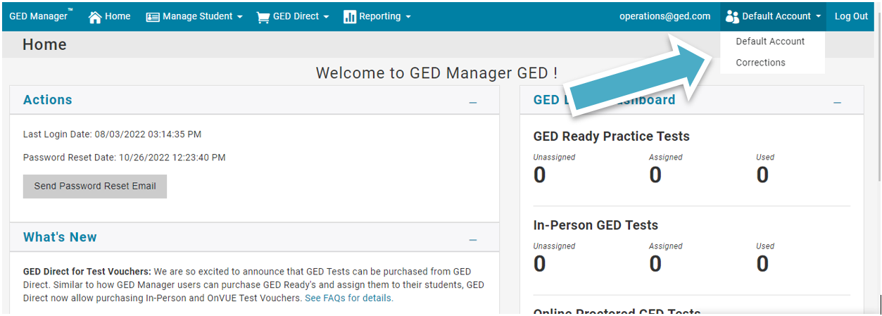
GED Manager: Dual Roles
The home page for GED Manager log-in will be the default account, which is the first account given. As needed, and where authorized, the user can change roles by clicking on "Default Account" in the upper right-hand corner of the screen.

Slide 15
GED Manager: Dual Roles
Some HSE professionals will receive dual roles within GED Manager and may need to toggle between these roles to manage their students and test takers.
Some individuals may receive differing permissions within their assigned GED Manager roles. For example, a test center coordinator who oversees both a PBT and CBT site will have one role/account within GED Manager but will receive specific permissions to manage PBT test events.
Examples of dual GED Manager roles include:
  A staff member who manages both an AHSEP and Adult Ed HSE prep program
  A staff member who oversees both an incarcerated and public test center
  A staff member who oversees both a preparation program and a test center
NYSED and GEDTS policy prohibits instructional staff from having any role in HSE testing. Instructional staff may be provided Student Authorized View permission only.

Slide 16
GED Prep Connect for Preparation Programs
GED Prep Connect is used for:
Recruiting new students - All Interested students who are not yet enrolled should be contacted.
Enrolled students must be accepted in GED Manager for their subtests scores to be credited to the preparation program (ties the program’s 5-digit code to the test taker).
Managing “GED Ready” and reviewing progress in “GED Ready Score Reports”
Monitoring Student Success with GED exam “Score Reporting*”
Identifying Graduates

Slide 17
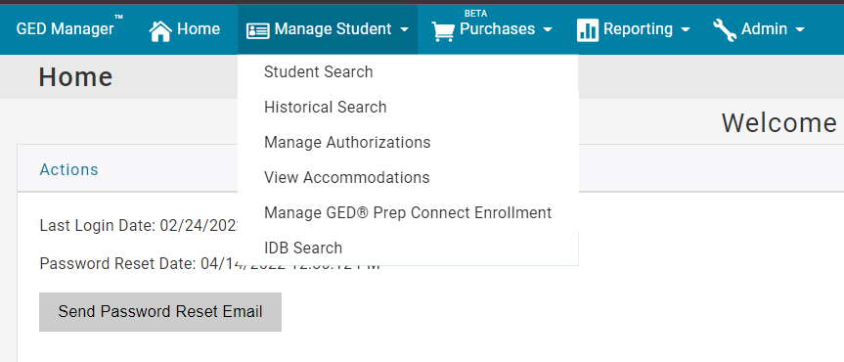
GED Prep Connect: Step 1

Slide 18
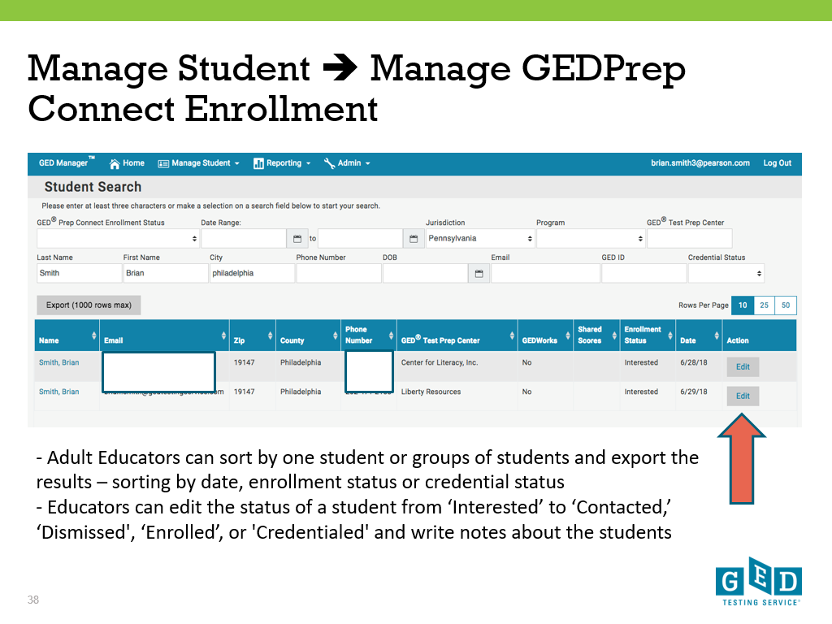

Slide 19
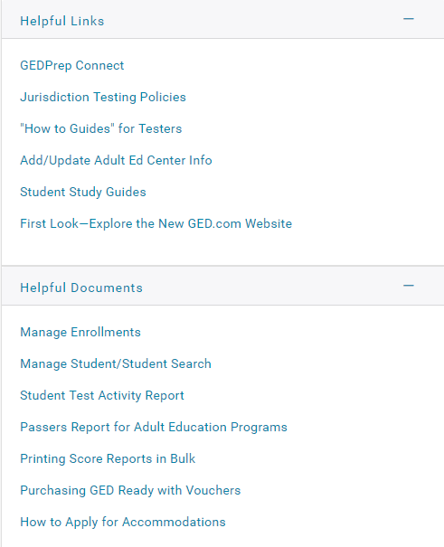
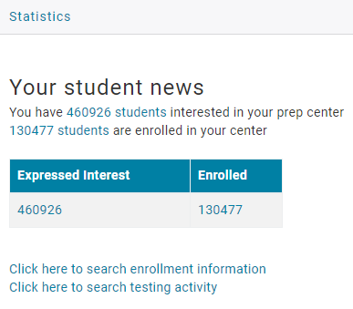
Adult Educators’ Home Page
New Students interested in your program
User Guides

Slide 20
Candidate “Enrollment” in Prep Connect
Interested or Enrolled
Preparation Program Staff use GED Manager to update the status of each Student to Enrolled, Contacted or Dismissed or Credentialed
Interested candidates who select your preparation program can be found in this part of GED Manager™.
All candidates will initially be listed as Interested, even if they are already enrolled in your program.
If a candidate indicates they are Interested, but are not yet enrolled, the preparation program staff will need to contact the candidate to provide information about the learning opportunities available.
If a candidate is already enrolled, preparation program staff must change that candidate’s status from Interested to Enrolled (for GED subtest scores to be connected to the preparation program).
Only students who are either over age 19 or who have had their Age Eligibility approved will appear in GED Manager.

Slide 21

Your GED Manager™ Menu
Student Search – Can look up one student at a time
Student Test Activity Report – Can download reports of students with specific testing activity, such as GED Ready
Manage Prep Connect Enrollment –Can find a list of new students interested in your program
Passers Report – This report only includes students who earn their diploma from 2022 GED testing, not subtest scores combined with grandfathering of prior TASC or GED scores, or who substitute Regent’s credit for passing subtest(s).

Slide 22
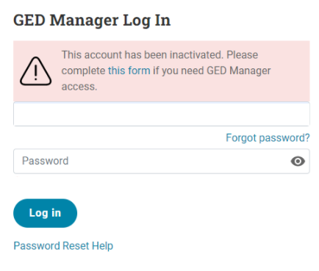
Reactivating a Deactivated GED Manager Account
GED Manager Accounts which are not accessed within 6 months are deactivated.
You will see the following message if your account was deactivated:
The GED Manager™ Account Reactivation Form can also be found on the GED website.

Slide 23
NYSED and GED Websites and Email Addresses
NYSEDHSE Office: http://www.acces.nysed.gov/hse/high-school-equivalency-hse
Please check HSE Announcements for important information and timely updates.
Test Center and Professional Email: HSETC@nysed.gov
Please send any questions you have regarding the content of this ppt training to the HSE professional email address. Include the name of your program and NYSED assigned code in the subject line.
Regents-HSE Exam Pathway Email: HSERAPP@nysed.gov
Student and Public Email: HSE@nysed.gov
HSE Call Center: 518-474-5906, Tu – Th, 10 a.m. - 12 p.m.
Pre-recorded detailed information is available when call center is closed.
GED TESTING SERVICE (GEDTS):
Candidates/test takers: General information about the GED® Test and to create an account and register to test: https://ged.com
Preparation Programs: https://ged.com/new-York-educators/

