Slide 1




Core Rehabilitation Services
RFP Bidder’s Conference
June 15, 2023

Slide 2


Introductions
Assistant Commissioner
Linda Schramm
Director of Operations
Lauren Newell
Coordinator of District Office Administration
James Barron
Associate Vocational Rehabilitation Counselor District Office Administration
Debbie Gabrione

Slide 3

Today's conference is being recorded
Today’s conference is being recorded and will be available online for 30 days.
https://www.acces.nysed.gov/procurement
Please put all your questions today in the chat. After today, you can email questions to CRS2024@nysed.gov.
We are accepting written questions through 6/16/23; answers will be posted 6/30/23.

Slide 4

Agenda
Welcome and Introductions
ACCES-VR Overview
CRS Application Process
New in this CRS RFP
Method of Award

Slide 5

An overview of ACCES- V R

Slide 6
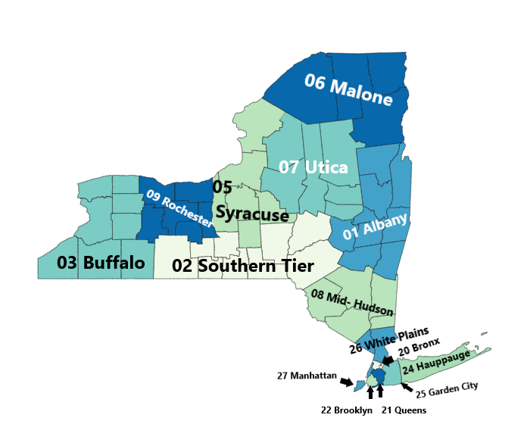
Acces V R overview part 2
Adult Career and Continuing Education Services (ACCES) is part of the New York State Education Department (NYSED)
ACCES consists of four offices:
  Adult Education Programs & Policy (AEPP)
  High School Equivalency (HSE)
  The Bureau of Proprietary School Supervision (BPSS)
  The Vocational Rehabilitation Program (ACCES-VR)
ACCES-VR has 15 district offices and 10 satellite offices throughout NYS that help individuals with disabilities pursue competitive, integrated employment.

Slide 7


ACCES-VR Overview
Mission:
ACCES-VR assists individuals with disabilities to achieve and maintain employment and to support independent living through training, education, rehabilitation, and career development.
Vision:
All individuals with disabilities who want to work will have the opportunity to achieve employment and independence.

Slide 8

An overview of ACCES VR continued
State Vocational Rehabilitation Agencies like ACCES-VR receive funding through the Federal Education Department’s Rehabilitation Services Administration (RSA)
To implement our Mission and Vision, ACCES-VR contracts with vendors to deliver services including:
  Post-Secondary Education
    Colleges
    BPSS Schools
  Sign Language Interpreting
  Vehicle Modifications
  Psychological Services
  Core Rehabilitation Services

Slide 9

Core Rehabilitation Services RFP
Five-year contract anticipated to begin 1/1/2024 and end 12/31/2028.
CRS includes the following major categories of services
  Pre-employment Transition Services (including Potentially Eligible) *page 12 of RFP
  Entry Services *page 20
  Assessment Services *page 22
  Employment Preparation Services *page 27
  Job Placement Services *page 32
  Supported Employment Services *page 39
  Assistive Technology/Rehabilitation Technology Services*page 48
  Driver Rehabilitation Services *page 50
  Adjunct Services *page 53

Slide 10

CRS Applicant Eligibility
Eligible Applicants Include:
New and current vendors (including Potentially Eligible Vendors)
Educational Institutions
Not-for-Profit Organizations
Community Rehabilitation Providers
Independent Living Centers
For Profit Organizations with experience providing VR services, including independent contractors
Sole Proprietors **
Refer to page 1 of RFP for additional eligibility requirements.

Slide 11

Subcontractors
The contractual relationship is between NYSED and the CRS vendor.
Subcontracting must be approved by NYSED.
Subcontracting can only account for 30% of the annual CRS budget.
Subcontracting is not allowed for the provision of supported employment services.

Slide 12

CRS Application Process

Slide 13
CRS RFP Application Timeline
06/01/2023
CRS RFP Released
06/15/2023
Bidders Conference Webinar
06/16/2023
All questions regarding CRS RFP must be emailed to CRS2024@nysed.gov.
06/30/2023
ACCES-VR will post answers to the questions on the ACCES-VR Procurement site.
07/5/2023
Notice of Intent to Submit an Application for CRS RFP
07/17/2023
CRS Application Due Date – NYSED WILL NOT ACCEPT LATE SUBMISSIONS

Slide 14
Pre-Qualification
for
Not-For-Profit
Bidders
Grants Gateway: https://grantsreform.ny.gov/Grantees
All not-for-profit applicants are required to be prequalified in the Grants Gateway by July 17, 2023 at 5pm, to be eligible to compete for this grant opportunity.
All other prequalification questions should be addressed to NYSED at prequal@nysed.gov. Grants Gateway has provided a plethora of materials on their website to help grantees.

Slide 15

Submission Document Requirements
Application/Basic Information Form (Attachment 1)
CRS Service Forms (Attachment 1A through 1I)
Resumes of qualified staff who will provide services and supervise staff providing services
  Staffing Qualifications (outlined on pages 58-61)
Syllabi or curriculums if required for specific services
Capacity Summary (Attachment 2)
Additional submission documents
Application check list available on page 75 of RFP

Slide 16
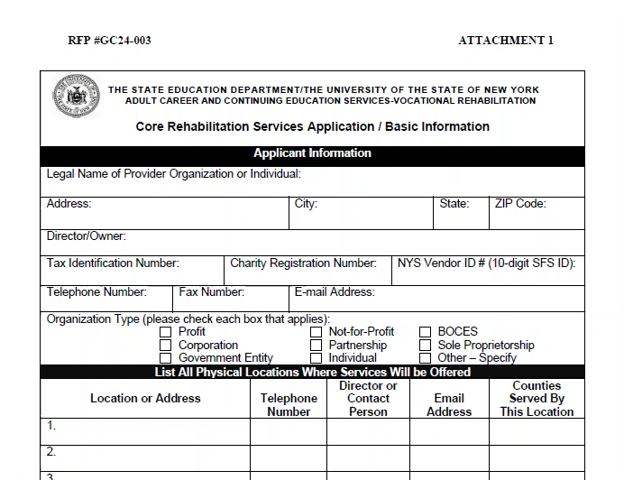
Application/Basic Information Form Attachment 1
Sections Include:
  Applicant Information (must include the legal name of the organization)
  Headquarter address and address of Office locations (accessibility)
  District Offices to serve
  Staff Qualifications
  Record Keeping
  Service Summary
  Acknowledgement and Understanding Signature

Slide 17
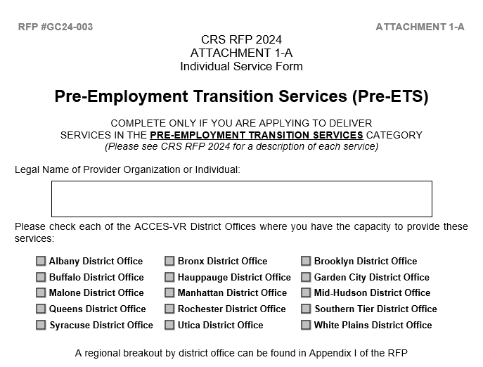
CRS Service Forms - Attachments 1A-1I
  Attachment 1A- Pre-employment Transition Services
  Attachment 1B- Entry Services
  Attachment 1C- Assessment
  Attachment 1D- Employment Preparation Services
  Attachment 1E- Job Placement
  Attachment 1F- Supported Employment
  Attachment 1G- Assistive Technology/Rehabilitation Technology Services
  Attachment 1H- Driver Rehabilitation Services
  Attachment 1I- Adjunct Services

Slide 18
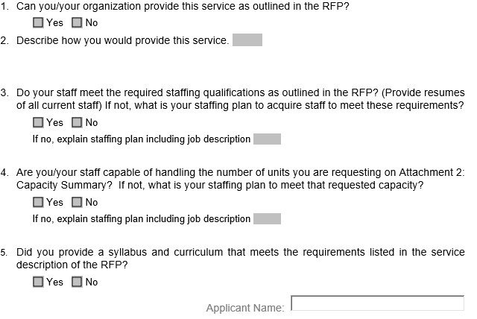
CRS Service Forms continued…
Describe how you will provide each service.
Include resumes, curricula, syllabi and credentials.

Slide 19
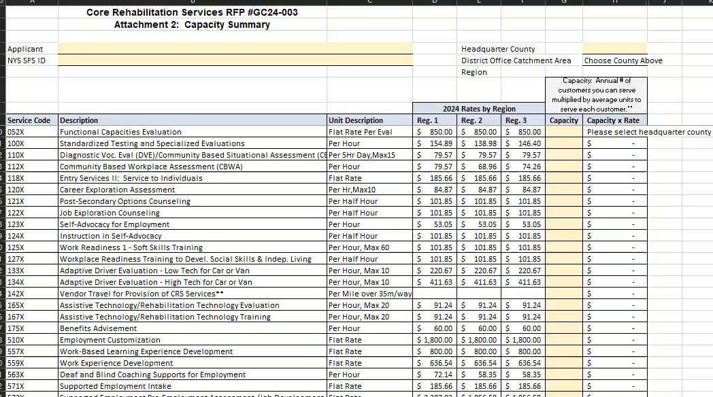
Capacity Summary - Attachment 2
Indicate how many units of each service your organization can provide on an annual basis, for each service for which you apply.
Please reference the RFP for unit description.
Requires Excel 2021 or newer

Slide 20

Other Submission Requirements
NYSED Substitute Form W-9 (If bidder is not yet registered in the SFS centralized vendor portal)
Vendor Responsibility Questionnaire – Instruction on pg. 71-72
Worker’s Compensation Documentation (required to be awarded a contract)
Disability Benefits Documentation (required to be awarded a contract)
Application Checklist – pg. 75

Slide 21

Proposal Transmittal Instructions
All documents must be submitted electronically to CRS2024@nysed.gov.
Subject line of email should read: RFP #GC24-003, plus the legal name of provider organization or individual.
All emailed documents must be received in the CRS2024@nysed.gov mailbox no later than July 17, 2023.
Proposals received after the due date will be deemed as non-responsive and will not get an award.
Do not wait until the last minute to submit your application, to avoid technical difficulties.
NYSED will send an automatic email confirmation upon receipt.

Slide 22

Introduction to RFP differences from last RFP

Slide 23

Differences in RFP
Options for Virtual Delivery of Services
Rate increases across all services
Staffing qualifications have been updated
Training for vendor staff providing Pre-ETS, Job Placement, and/or Supported Employment Services
Updated Performance Measures – Timeliness, Quality, Employment Outcomes
Additional time for Report Submission when a copy of a paystub is required

Slide 24

Billing
ACCES-VR contracts do not allow for the funding of services in advance.
No Show Rates are being discontinued; Drop Out rates remain.
Use of Claim for Payments is being discontinued.
Authorizations – available in real time through Aware Vendor Portal.

