Slide 1
CRS
BILLING PROCESS
Notes:
Welcome to the Core Rehabilitation Services webinar for the Billing Process

Slide 2
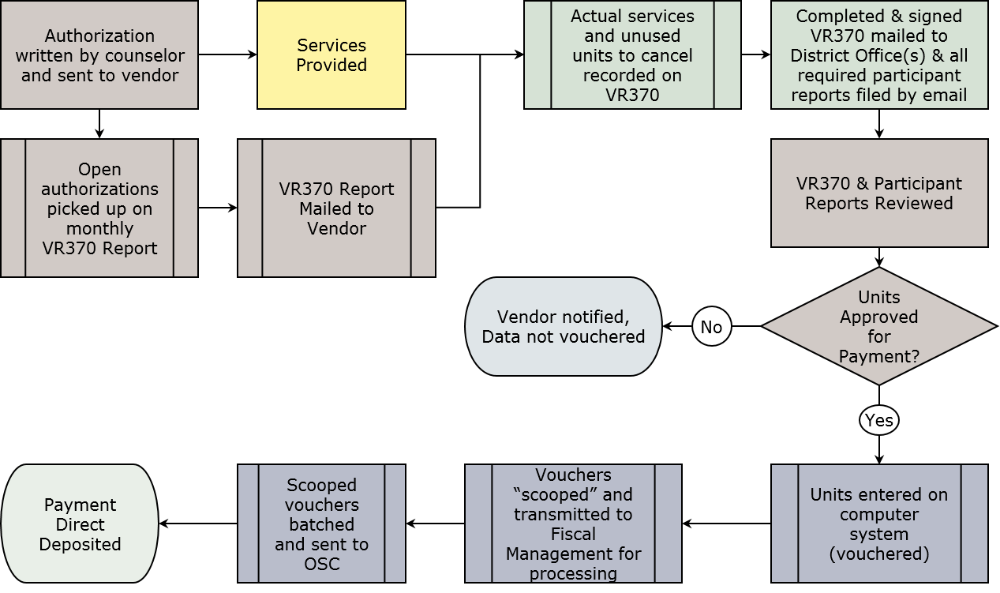
Individual Consumer Services From Authorization to Payment
Notes:
Flowchart taking you from authorization to payment:
Authorization for one or more services is written by the counselor and sent to the vendor
Monthly, a snapshot of open authorizations is taken to create the monthly VR-370 billing form
In the first five days of the month, the VR-370s are mailed from Central Office in Albany to each vendor
After services are provided, vendors record the actual services provided and units on the authorization to cancel on the VR-370
The completed VR-370 pages are mailed to the district office(s).
The VR-370 reports and individual participant reports are reviewed
If there are services that are not approved, the vendor is notified, and that data is not entered into our system for payment (vouchered).
All reported services that are approved for payment are vouchered.
Vouchers entered at the local offices are scooped nightly and transmitted to Fiscal Management for processing.
At least once per month, the scooped vouchers are batched and sent to the Office of the State Comptroller for payment issuance.
Payment completed by ACH (direct deposit). Please set up ACH payments through the Comptroller’s office if you have not done so already. This is a requirement of the contract.

Slide 3
Billing for Individually Authorized Services
The monthly VR-370 form lists all authorized services and must be used. No individual invoices.
Complete the VR-370 report & mail to each appropriate district office every month for individual participant services.
District Office reviews and enters approved units onto centralized data system.
Data is “scooped” and transferred to Fiscal Management for payment
Batched payment request sent to OSC for processing.
Notes:
This slide reiterates flowchart on previous slide.

Slide 4
Step 1 – VR370 REPORT
Notes:
Example of the VR-370 report. Please note the reporting month in the header. This form is generated monthly, and vendors are expected to return it to the appropriate district office by the 15th of each month. Forms received after the deadline will be processed after those received earlier. Vendors run the risk of their billing being entered in the following month, and a delay in payment.
The facility’s six-digit ACCES-VR vendor code and agency name and the local district office are also in the header. For those serving more than one office, the authorizations for each office are grouped together. The report must be separated by office and pages submitted to the correct district office.
Each service row contains: the client’s name, ID number, authorization number, line number, case service code, authorization start and end dates, units authorized and the remaining unit balance.
Then there are spaces for you to record: the start and end date of service within the reporting month, the units provided, space for a check mark to indicate that the remaining balance of the authorization should be cancelled. The final two columns are for district offices to record that the program report was received and if the line was approved and processed for payment.

Slide 5
VR370 REPORT
Be sure to sign report
Notes:
At the end of each district office section there is a page with blank rows. This is to be used when recording services provided in an earlier month, but not yet billed.
Record the client’s ID, first three letters from the last name, authorization number, line number, case service code, start and end date of service and the units provided.
At the bottom of the form is an attestation that the information is true and correct and supported by the service provider’s internal records. This attestation must be signed, and the original sent to the district office. Failure to sign the form will result in form rejection and payment delays. Email and fax copies are not acceptable for the VR-370 form.

Slide 6
VR-370 Report
VR-370 should be sent to each appropriate district office by the 15th of the month, as noted in Attachment D of the contract. For example, the March 2019 report should be sent by April 15, 2019.
Do not send in copies of the VR-370 to the Central Office in Albany. Questions regarding the VR-370 should be directed to your district office liaison.
This report displays authorizations for the open contract year(s). All billing for the prior year is due by March 31st each year. Prior year authorizations will no longer be displayed on the April report.
Notes:
For all vendors, the reporting deadline is the 15th of each month for the VR-370 and all supporting documentation as noted in Attachment D of your contract.
For example, the March 2019 VR-370 report is due to the local office(s) by April 15, 2019.
Do not send in copies of the VR-370 to the Central Office in Albany. Questions regarding the form should be directed to your local district office liaison.
Please keep current on your billing. We reconcile annually, and all billing for the prior year must be submitted by March 31st annually. Therefore all billing for 2019 authorizations, including the VR-370 and any related program reports, must be submitted to the local offices by March 31, 2020. Late submissions will not be honored. The 2019 authorizations will no longer be displayed on April 2020 reports.

Slide 7
Utilization Report
A Utilization Report is a cumulative report that lists all authorized services you provide to participants during the contract year. It provides detailed information on Authorization Vouchers issued to you including the dates that services were vouchered and/or cancelled. See sample that follows.
The report is sent by e-mail to up to six vendor-designated recipients.
Updates to recipients list must be sent to CRS2@nysed.gov.
Report format will be revised for 2019
No longer tracking percent utilized by units
Will add up totals for:
Non-Supported Employment
Supported Employment Intensive
Supported Employment Extended for Youth
The utilization report will not include any spending for Group Orientation or SE Extended for Adults
Notes:
Utilization Reports
Along with the monthly VR-370 report, ACCES-VR issues utilization reports. A utilization report is a cumulative listing of all authorizations issued to your agency during the open contract year(s). It provides detailed information including the dates of services and units vouchered and/or cancelled. See the sample that follows on the next slide.
This report is sent by e-mail to up to six vendor-designated recipients. Any updates to the recipients for your agency should be sent to CRS2@nysed.gov.
The report format is being revised for 2019 due to changes in how the contracts were awarded. We are no longer tracking the percent utilized by units, since units were not awarded for each service this time. We will instead total up each major cost category for comparisons: Non-Supported Employment, Supported Employment Intensive, and Supported Employment Extended for Youth.
This report does not capture spending for Group Orientation or Supported Employment Extended Services for Adults, as these services do not receive an authorization for an individual.

Slide 8
Utilization Detail Report
Notes:
Utilization Detail Report Example
This is a cumulative report for the open contract year(s). Because authorizations cannot cross contract years, and we reconcile annually, authorizations will fall off this report each year after the reconciliation period ends. The reconciliation process is detailed in Attachment D of your contract. A reminder will be issued each year in advance of the reconciliation deadline.
This report is grouped by Case Service Code and alphabetical by participant within each group. For each participant you will see the authorization and line number, the start and end date of the authorization, units authorized, the rate and total amount. As you bill for services against the authorization, you will see the vouchers recorded with the date it was entered, the start and end date of service (which must be within the authorization start and end dates), units vouchered and amount for each voucher. Next you will see the balance remaining for that authorization line. If you indicated that the balance should be cancelled, you will see a cancellation date line, with the units and amount cancelled.
At the very end of this report is a summary for each case service code and services used by each office that has issued an authorization to your contract. Also, we issue a voucher summary report as a separate document. No participant data is on this report. Both summary reports are undergoing changes for the new contract term. You will receive more information as we get closer to the first billing cycle in February. Services for January 2019 will be reported by February 15th.

Slide 9
No-Show/Drop-Out Billing
Applies to some, but not all, CRS services
See Attachment B-2 of the contract, or
2019-23 Core Rehabilitation Services Program Guide online http://www.acces.nysed.gov/vr/core-rehabilitation-services
After discussion with counselor:
Hourly-rate services –
Bill for ½ hr. for no-show on VR-370, cancel balance of authorization
For drop-outs, bill for actual hours provided
Non-hourly rate – Cancel original authorization in full. New authorization with primary code (i.e., 110) with support code “D” (i.e., 110D). This authorization will appear on next VR-370 report to be billed against.
Fee is $30 for non-hourly applicable services.
Notes:
No-Show and Drop-Out billing
Some CRS services allow for no-show and drop-out billing. Please refer to Attachment B-2 of your contract or the 2019-23 Core Rehabilitation Services Program Guide, which will be posted online soon in the Core Rehabilitation Services section of our website.
Please work with the participant’s ACCES-VR counselor before requesting the no-show/drop-out fee.
For Hourly-rate services when it is agreed that the participant will not receive the service, you may bill for ½ hour for a no-show on the VR-370 and check to cancel the balance of the authorization. For drop-outs, you may bill for the actual hours provided.
For non-hourly rate services where this is allowed, the original authorization must be cancelled in full. A new authorization with the primary code (i.e., 110, or a summary code for assessments) with the support code “D” (i.e., 110D) will be created. This authorization will appear on the next VR-370 form to be billed against. The fee authorized is $30 .

Slide 10
Billing for Services to Groups
Entry Services 1 – Group Orientation Only
One quarterly AC3253-S “Claim for Payment” with all sessions held during the quarter reported.
Roster(s) of attendees attached to claim.
AC3253-S “Claim for Payment”
Can be downloaded at:
http://www.osc.state.ny.us/agencies/forms/ac3253sf.pdf
Notes:
Billing for Services to Groups
This is for Entry Services 1 – Group Orientation only. Per the terms of the contract, group orientation services are to be billed quarterly for all sessions held during the quarter reported.
The roster(s) of attendees must be attached to the AC3253-S “Claim for Payment” form. This form can be downloaded from the Office of the State Comptroller’s website at the link displayed here.

Slide 11
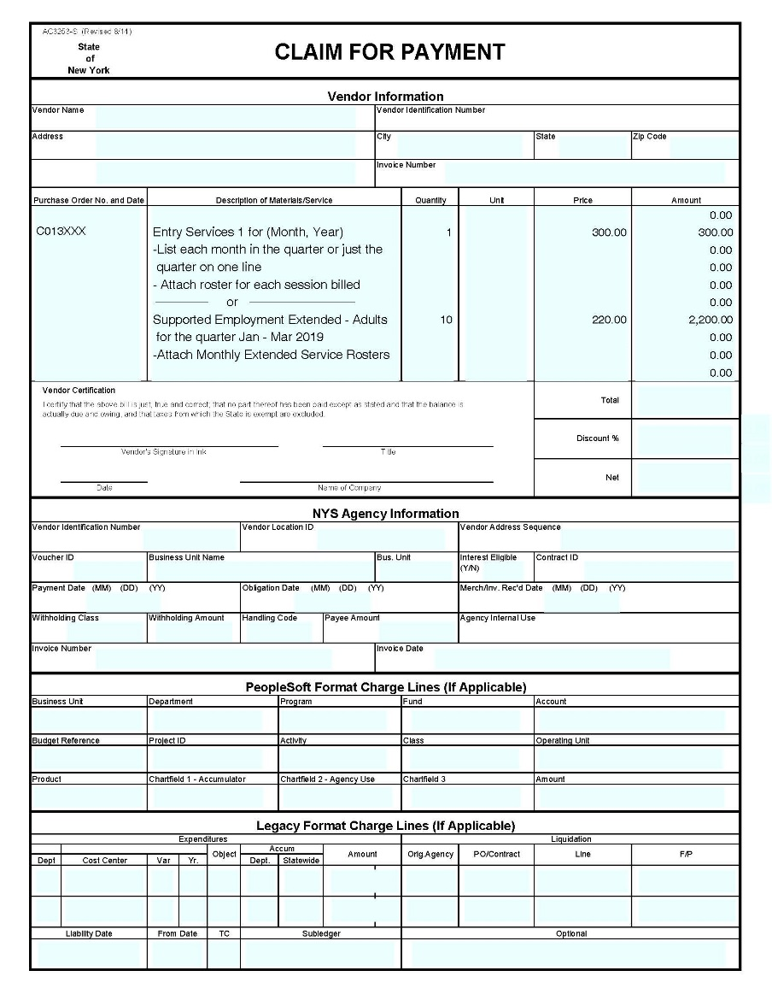
Claim for Payment Form
Entry Services 1 and Supported Employment Extended for Adults must be reported on separate claim forms.
Do not include participant-specific information on the form.
Notes:
Here is an example of the Claim for Payment form. It is a fill-in form which may be used for Entry Services 1 – Group Orientation and Supported Employment Extended Services for Adults. Both services must be reported on separate claim forms. Do not include participant-specific information on this form. After completing the header information, please record your contract number in the Purchase Order No. and Date column. In the Description of Materials/Services box, for Entry Services 1, indicate “Entry Services 1 for (Month, Year)”, you may list each month in the quarter or just the total for the quarter on one line. For Supported Employment Extended – Adults, indicate “Supported Employment Extended – Adults for the quarter (Months, year).
List the quantity of Entry Services sessions or SE total of monthly units in the quantity column. List the rate for each session/monthly unit in the Price column and the appropriate total in the Amount column. The total field will calculate automatically. Print the form and sign it in the Vendor Certification section prior to mailing to the appropriate location.

Slide 12
Billing for Services to Groups (cont.)
The Claim for Payment and Roster of Participants should be sent to the local district office which requested the service
All quarterly claims are due to the district offices by the 15th of the month following the close of the quarter.
DO will review and forward approved claims and rosters to Fiscal Management for processing
Notes:
Entry Services 1 – Group Orientation forms go to the local district office that requested the session. All quarterly claims are due the district offices by the 15th of the month following the close of the quarter. The district office staff will review and forward approved claims and rosters to Fiscal Management for payment processing.

Slide 13
Supported Employment Extended Services
578X – Extended Supported Employment (Adults)
No authorizations for this service at this time.
Will include any participants under 25 already in extended services by 12/31/18
Vendors must send signed original to ACCES-FAST in Albany and file a copy of the roster with the local district office(s).
Notes:
Supported Employment Extended Services
578X – Extended Supported Employment (Adults)
There is not much change in how this service is handled from the prior contract term. No individual authorizations will be issued for this service, at this time.
As we transition to this new contract, participants who are under 25 and are already in extended services by 12/31/18 will be reported quarterly on the rosters. ACCES-VR will not be going back to write 582X – Supported Employment Extended Services for Youth authorizations for those individuals.
Supported Employment Extended for Adults claims, with original signature and rosters will be sent to Central Office in Albany. File a copy of the roster with the local district office(s).

Slide 14
Supported Employment Extended Services
One report form for Extended Services for Adults
ACCES-VR Funded only - OPWDD 2003 Transfers have been folded into ACCES-VR Funded totals, with the same rate.
Form calculates allowable reimbursement based on participants receiving two visits per month, with both dates recorded on the forms.
Transfer quarterly total to Claim for Payment form and send with Extended Service Report forms to Central Office.
Notes:
This contract term drops the separate rate for the 2003 OPWDD Transfers. All individuals from 2003 that were still in extended services are now reimbursed at the same rate as all other SE Extended Services. The standard rate has been increased in this contract to reflect that change.
The Supported Employment Monthly Report of Services Provided calculates the allowable reimbursement based on the number of participants receiving two visits per month, with each date recorded on the form. If there is only one date recorded for an individual, that line will not be added to the total.
Transfer the monthly totals to the Claim for Payment form once per quarter and send with the rosters to the Central Office ACCES-Fiscal and Administrative Services Team (ACCES-FAST).

Slide 15
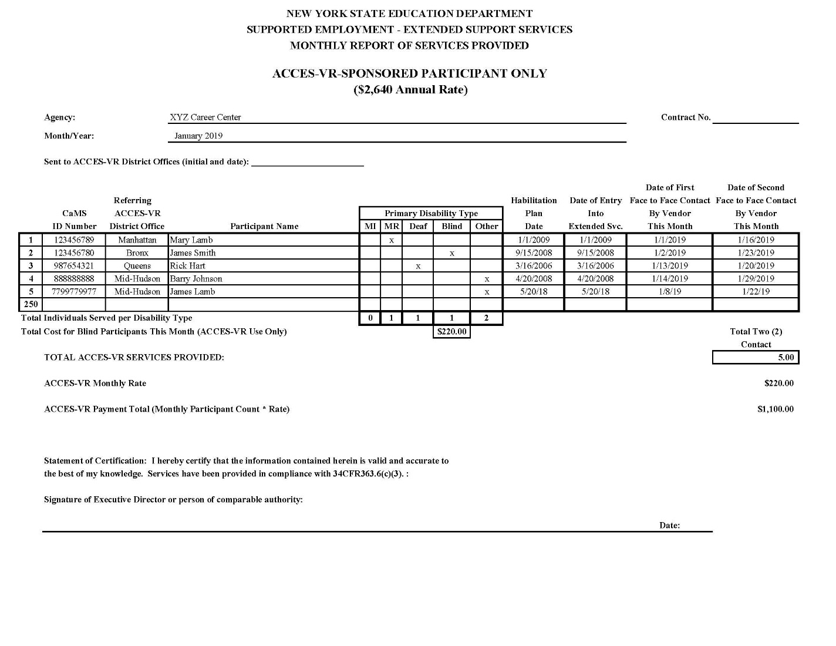
Supported Employment Extended Services
Notes:
Here is an example of the monthly roster. It is important to include information in all columns, including the participant’s CaMS ID number from when their case was open and the referring district office. Please include the participant’s name and their primary disability type. New to the form is a column to record the Service Plan Date. Record the date the participant entered extended services and the first and second dates of face to face contact with the participant by the vendor.
The total box should complete automatically based on data recorded in the rows. Please do not change the data types to avoid formula errors.
Sign and date the form at the bottom before sending to ACCES-VR FAST.

Slide 16
Supported Employment Extended Services
Supported Employment Extended for Youth
Eligible participants transitioning to extended services after 1/1/19 will receive an authorization for 582X.
Program Reporting and billing for 582X will follow the same process as any other participant service
VR-370
1 unit/mo for each participant receiving 2 face-to-face contacts
VR-582
Record the monthly activity with the participant
Notes:
Supported Employment Extended Services for Youth (582X)
Eligible participants transitioning to extended services after 1/1/19 will receive an authorization for 582X.
Program reporting and billing for 582X will follow the same process as any other authorized participant service.
On the VR-370, bill one unit per month for each participant that received two face-to-face contacts. The annual rate of $2,640 has been broken down into 12 monthly units at $220 per monthly unit.
A VR-582 form is required for each 582X participant. This form records the monthly activity with the participant. This will be reported electronically with other program reports submitted for the month.

Slide 17
Vendor Resources
Vendors can access payment information through the NYS Financial System (SFS).
NYS OSC State Vendors main page: https://www.osc.state.ny.us/vendors/index.htm
SFS Training for Vendors: https://upk.sfs.ny.gov/UPK/VEN101/data/toc.html
Notes:
Vendor Resources
Vendors can access payment information through their Vendor Portal in the New York State Financial System (SFS). More information can be found on the Office of the State Comptroller’s website at the first link. OSC also provides SFS training for vendors which can be found at the second link.

Slide 18
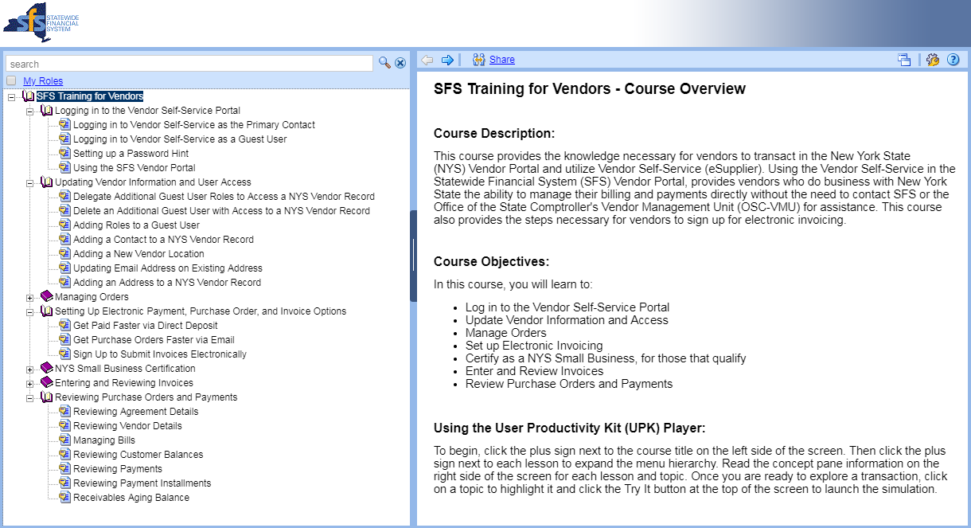
SFS Training for Vendors
Notes:
This is a screenshot from the SFS Training for Vendors website. Here you can find training on logging in to the Vendor Self-Service Portal, updating your information and user access, setting up electronic payments and reviewing payments. Some of the sections such as managing orders and electronic invoicing do not apply to this contract. Due to the complexities of our case management system we cannot transition this contract to e-invoicing at this time.

Slide 19
Deciphering the Invoice field
Standardized Invoice Field on payment record for Individually-Authorized Services
Example: 2621234561571XPWILX9999021819
Break it down:
26 = District Office #
2123456 = Authorization #
1 = Authorization Line #
571X = Case Service Code
PWIL = 1st Letter of Participant’s first name, 1st three of last name
X9999 = ACCES-VR schedule #
021819 = ACCES-VR District Office Invoice Entry Date
Notes:
When you receive payment and review the details of the payment in the vendor portal, you will see a long string of characters in the Invoice field for each item making up that payment. We standardize the invoice field on the payment record. For individually authorized services, let’s break down an example invoice field to help you decipher what it all means.
Example: 2621234561571XPWILX9999021819
Break it down:
26 = District Office # (the codes are listed on the next slide)
2123456 = Authorization # (always starts with a 2 for CRS contracts)
1 = Authorization Line # (there may be several lines on an authorization)
571X = Case Service Code (this code is for Supported Employment Intake)
PWIL = 1st Letter of Participant’s first name, 1st three of last name (for example Paula Williams)
X9999 = ACCES-VR schedule # (internal tracking number)
021819 = ACCES-VR District Office Invoice Entry Date (date the VR-370 line was entered on our system at the local office)

Slide 20
Deciphering the Invoice Field (cont’d)
Supported Employment Extended Services for Adults
Example: C013346 1-3/19 Q1 SEP EXT CRS
Entry Services I – Group Orientation
Example: C013346 JAN-MAR 19 ESI CRS
Break it down:
Contract #
Time Period (Months & Quarter#)
Service type (Supported Employment Extended – Core Rehabilitation Services)
Notes:
The invoice field for Supported Employment Services for Adults and Entry Services I – Group Orientation should display the contract number, the time period (Months and/or Quarter #) and the Service type.
For example, SE Extended for Adults for the January – March 2019 period for contract C013346 should read: C013346 1-3/19 SEP EXT CRS
Entry Services I should read: C013346 JAN-MAR 19 ESI CRS
This is a manual entry, and may vary a little based on the person entering it, but it should be clear what the payment line is for.

Slide 21
District Office Codes
01: Albany DO 20: Bronx DO
02: Southern Tier DO 21: Queens DO
03: Buffalo DO 22: Brooklyn DO
05: Syracuse DO 24: Hauppauge DO
06: Malone DO 25: Garden City DO
07: Utica DO 26: White Plains DO
08: Mid Hudson DO 27: Manhattan DO
09: Rochester DO
Notes:
This slide lists the district office codes

Slide 22
Contact Information
Vendors will be instructed to reach out to their district office liaison for questions regarding the VR370s and the billing process. The current contact list will be updated and posted on the Core Rehabilitation Services page:
http://www.acces.nysed.gov/vr/core-rehabilitation-services
2014-18 contact list: http://www.acces.nysed.gov/vr/vr370-liaisons
The Central Office FAST contact information for VR-370 Mailing address changes and Utilization Report email contact changes:
Dana LeBeau - dana.lebeau@nysed.gov
Shannon Schühle - shannon.schuhle@nysed.gov
CRS2@nysed.gov – preferred contact for vendors to use
(518) 486-6585
Mailing address: NYSED ACCES-FAST, 89 Washington Ave., Room 560 EBA, Albany, NY 12234
CRS Information Online:
General: http://www.acces.nysed.gov/vr/core-rehabilitation-services
Notes:
Contact information
Vendors will be instructed to reach out to their district office liaison for questions regarding the VR370s and the billing process. The current contact list will be updated and posted on the Core Rehabilitation Services page. The current contact list is still posted online at the link listed here.
Should you need to reach FAST to update your VR-370 mailing address and/or change the email contacts for the monthly utilization report, please contact either Dana LeBeau – dana.lebeau@nysed.gov or Shannon Schühle (pronounced Sheely) – shannon.Schuhle@nysed.gov. We prefer that vendors use CRS2@nysed.gov for routine messages, as this is monitored by more staff. Our unit phone number is (518) 486-6585. Mailing address: NYSED ACCES-FAST, 89 Washington Ave., Room 560 EBA, Albany, NY 12234
CRS Information Online: General: http://www.acces.nysed.gov/vr/core-rehabilitation-services. Please note this website is currently undergoing updates for the new contract term. When you land there now, you may still see the information for the 2014-2018 CRS contract term.

Slide 23
CRS Electronic Reporting
Technology Requirements
Confidentiality
Conceptual Overview
Electronic Reporting
Win-Zip
Sending Reports
Confirmation of Reports Received
Organizing Files and Containers
Additional Resources

Slide 24
Technology Requirement
Technology Requirement refers to the capacity to provide electronic reports.
Using encryption software that must be compatible with ACCES-VR.
Technology requirements are subject to change during the five-year contract term.
Notes:
To make the electronic system work there are some technology requirements.

Slide 25

Confidentiality
All devices (e.g., laptops, flash drives or any other electronic storage devices) that store SED information/data MUST be encrypted.
Notes:
SED/ACCES-VR must ensure that confidentiality is maintained throughout the process.

Slide 26
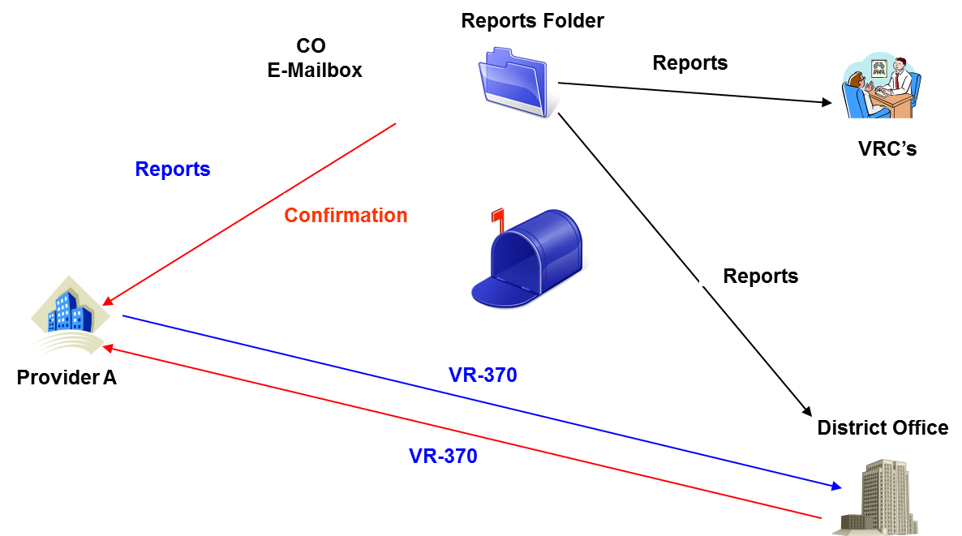
CRS Electronic Reporting Conceptual Overview
Notes:
Providers need to create their CRS Service reports as individual files. If the report requires an attachment (Detailed Assessment Report, Wage verification….) the deliverable report form and attachment must be combined into one document (scanned) so that the report and attachments are one file.
Using WinZip then zip the individual files and create a “container”
Provider staff will email a zipped container of CRS service delivery reports to an E mail box in ACCES-VR central office
The service delivery reports will need to follow certain naming formats
The E-mail subject will need to follow certain naming formats as well
A program will scan the Email box at CO looking for new Emails
It will unzip the container and separate out the individual service reports
Using the individual file names it will look them up in our database
It will move them to the server at the associated District office and send an email to the counselor telling them the CRS service delivery reports are in. The VRC can look at the report and take action at that time.
Email the provider that the service delivery reports have been received and list a “success” or “failure” status for each report.
When the VR370 is received in the district office, finance staff will compare the completed VR370 lines to the reports received. For each payment, finance staff will look to see if the report has been received and if it has, they will voucher the VR370 entry. If a service delivery report for a consumer has not been received, finance staff will record a ‘No’ on the VR370.
A copy of the VR370 showing what was paid will be sent to the provider.

Slide 27
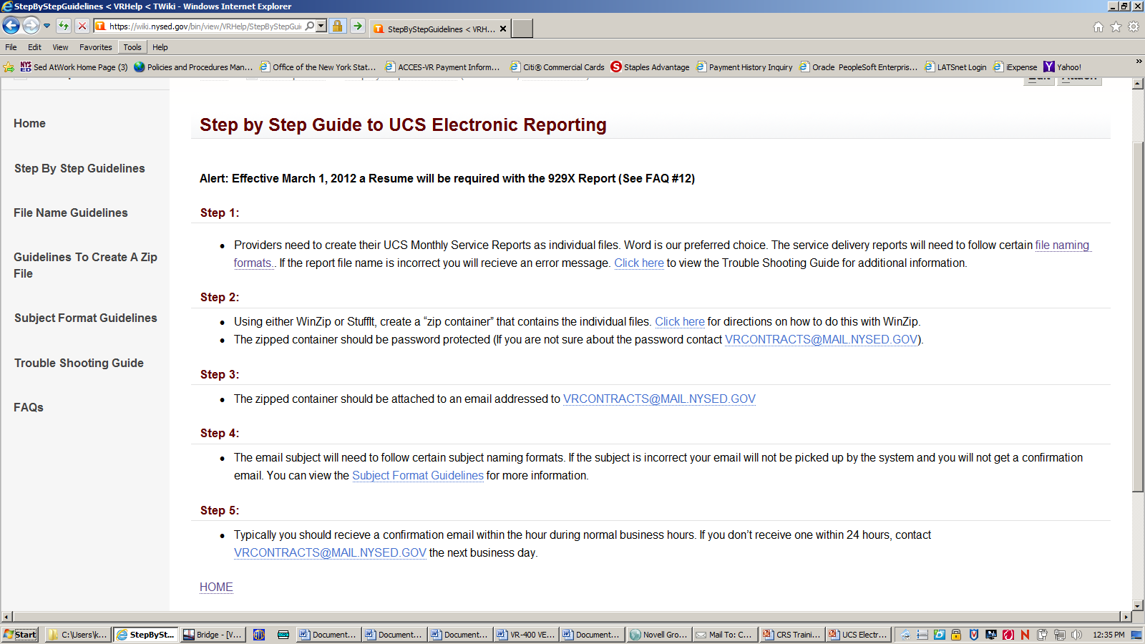
CRS Electronic Reporting Guidelines
Are located at: https://wiki.nysed.gov/bin/view/VRHelp/StepByStepGuidelines
Note new email address: vrcontracts@nysed.gov
Notes:
This slide demonstrates the Step by Step Guide for Electronic Reporting. This guide will be updated for CRS 2.0. Please note that the correct email address for submitting electronic reports is vrcontracts@nysed.gov.

Slide 28
CRS Electronic Reporting
Electronic reports must be submitted for individually-authorized CRS services provided.
Electronic reports are not required for:
Entry Services I – Group Orientation
Supported Employment Extended Services for Adults
Must use our report forms.
Attachments need to be combined with the report form so that each service has one file for electronic submission. (i.e. Detailed Assessment reports, wage verification, additional pages listing job development contacts for the MPAR and MPSE)
Notes:
Revised the report formats
Made them into templates
Standardized them
Latest report forms are on our website
Must use our forms
Some services you do not report electronically on
Services to groups – Entry Services 1 – Group Orientation

Slide 29
Signatures Required
Reports must be physically signed and scanned so that they can be submitted. ACCES-VR will not accept electronic signatures (typed) for the reports submitted. Original handwritten signatures are required for the reports.
The hardcopy with original signature should be maintained in the provider record

Slide 30
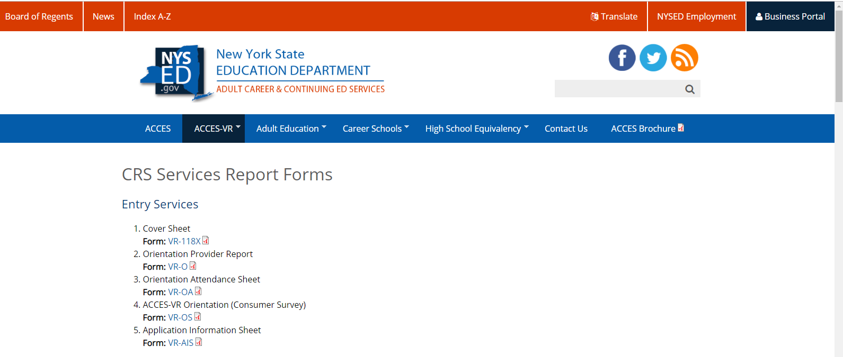
CRS Report Forms
Are located at:
http://www.acces.nysed.gov/vr/crs-2-service-report-forms
Notes:
Location of CRS Report forms with link and screenshot

Slide 31
CRS Service Delivery Report File Names
31
The Format MUST be:
Authorization# CSCX MMM YY.docx
Ex. 2100021 931X Jan 19.docx
→The CRS Report file names are used to identify the participant, authorizing office, service and counselor.
Any variations in the format will cause delivery to fail.
there must be 3 spaces as indicated
4 character case service code
3 character month
2 digit year
Notes:
CRS Service Delivery Report file names
The Format MUST be:
Authorization# CSCX MMM YY.docx
Ex. 2100021 931X Jan 19.docx
→The CRS Report file names are used to identify the participant, authorizing office, service and counselor.
Any variations in the format will cause delivery to fail.
there must be 3 spaces as indicated
4 character case service code
3 character month
2 digit year

Slide 32
One more time!
32
CRS Service Delivery Report Names Must be:
2594671 929X Jan 19.docx
Seven Digit Authorization #
Case Service Code
MMM <space> YY the Service was Delivered
Notes:
File names must follow this format

Slide 33
Report Names - Examples
33
2867549 110X May 19.docx
2875320 790X Apr 19.docx
2867453 929X Jan 19.docx
2867453 RESU Jan 19.docx
2867453 MPAR Feb 19.docx
2671202 165X Jun 19.pdf
Notes:
Report name examples

Slide 34

Job Placement - 929X, 935X and 572X
Month 1 - Submit VR-929X/VR-935X – Job Placement Services report form
Month 2, 3, 4 - Submit VR-MPAR – Placement Activity Monthly Report form
A resume must be submitted for payment of either 929X or 935X, in the same file container.
Monthly, after 572X, Submit VR-MPAR – Job Development Monthly Report

Slide 35
WinZip
WinZip (Windows PC)
can be purchased via the website www.winzip.com
or
STUFFIT (Macintosh PC)
Notes:
The basic version of WinZip is a universal Windows 10 app. 7-Zip can also be used if you have it, but we do not recommend buying it if you are not familiar with it.

Slide 36
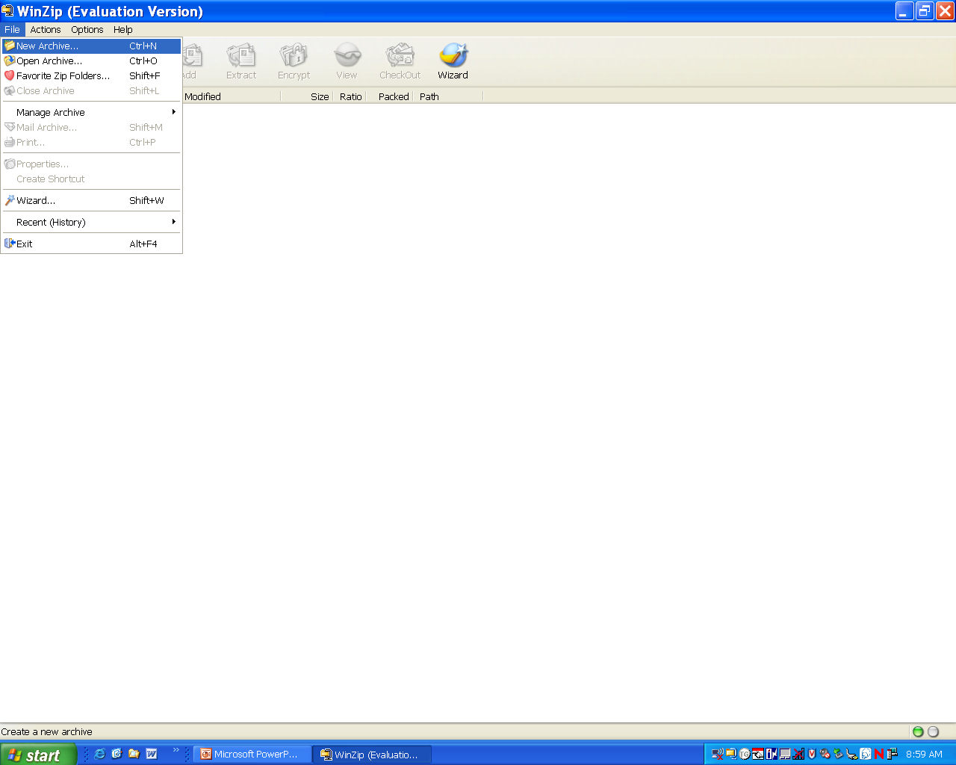
Using WinZip
Run WinZip
Click “File” then
“New Archive” (or click the “Zip My Files” button)
Notes:
This slide is for an older version of WinZip.

Slide 37
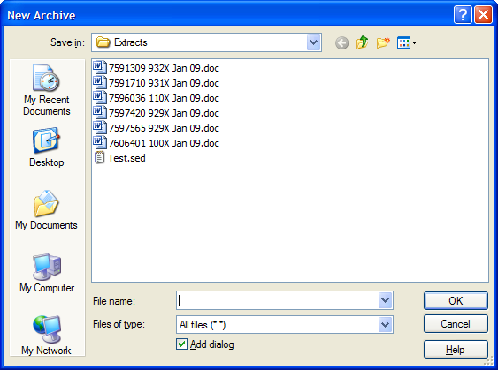
Creating a Location and Container to Hold the Zipped Files
Select a location for the zipped container
Enter a Container (file) name and click “OK”. (ex.20140105.sed)
→Note: The container name must end with “.sed” and must not end with “.zip”
Notes:
This slide is for an older version of winzip, regarding creating a container location and name.

Slide 38
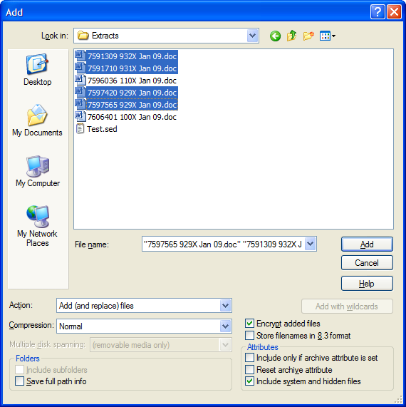
Selecting the Report Files to Zip
Check the “Encrypt added files” box
Select the CRS service delivery files you want included and click “Add”
Note →You must check “Encrypt added files” before you select and “Add” files
Notes:
Selecting the reports to zip and add to the container.

Slide 39
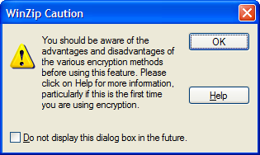
Caution Message
Click “OK” on the caution box that appears.

Slide 40
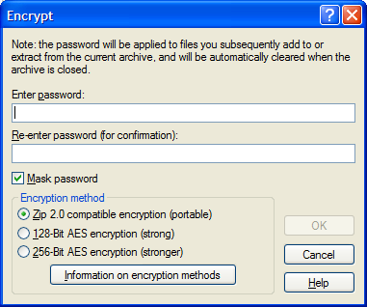
Password Protecting the Zipped Container
Enter, the password twice and click “OK”.
Go with default encryption method.
If you forget password: Send email to: vrcontracts@nysed.gov

Slide 41
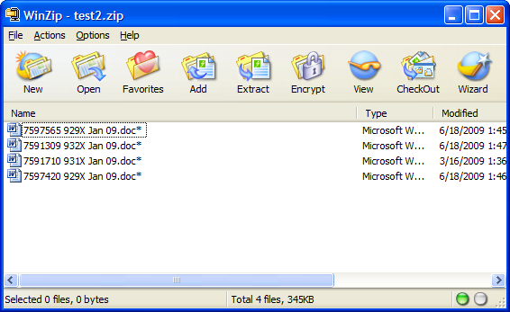
Finishing up
Click “File” then “Close Archive”.

Slide 42
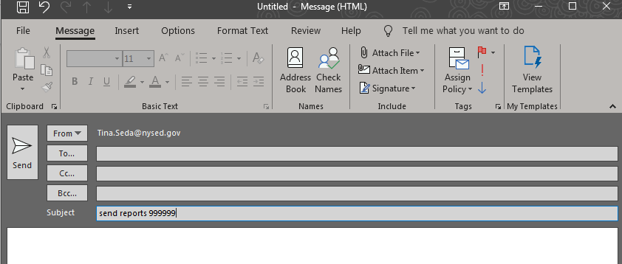
E-Mail the Zipped Container (.sed) to SED
vrcontracts@nysed.gov
Only send one container per Email.

Slide 43

Sending Reports
E-Mail zipped container (.sed) to:
vrcontracts@nysed.gov
Subject line must read:
send reports <Vendor ID>
Ex. send reports 123456
Vendor ID is six digit # printed on the authorization
leading zeros are required in the Vendor ID
must be two spaces in the subject line (one between ‘send’ and ‘reports’ and one between ‘reports’ and ‘<vendor id>’)
Notes:
Q. What if you send the same file twice?
The second one will overlay the first one

Slide 44

Confirming E-Mail Receipt Confirmation
The Provider will receive a confirming e-mail containing a list of the CRS Service Delivery Report Files that were sent. Following each report name will be a status.
“Delivered” means the report was processed successfully.
“Failure” means the report was not processed successfully.
Notes:
On our side we will split the container you sent us into the individual report files.

Slide 45
Example Receipt Confirmation
>>> VRCONTRACTS 2/5/2019 9:19 AM >>>
Reports received:
2591310 932X Jan 19.doc Failed Incorrect authorization number
2596036 110X Jan 19.doc Delivered
2615770 931X Jan 19.doc Failed --- No match on case service code

Slide 46

Reasons for Failure
***No Match on Authorization Number
Authorization # does not exist in our database – verify the correct AV# was used in the report file title.
***Incorrect Authorization Number
Vendor ID on the Authorization does not match your
Vendor ID - verify the correct AV# was used in the
UCS Service Delivery Report file title.
***No Match on the Case Service Code
The CSC in the CRS Service Delivery Report file title does not match any of the case service codes on the authorization – Verify the report file title contains the correct Authorization # and CSC
Notes:
Go to win zip demo

Slide 47
Organizing Files and Containers
Below is one suggested way to keep the files and containers organized.
Individual Files Ready to Send
2595634 563X Aug 19.doc
2596671 929X Aug 19.doc
2597812 929X Aug 19.doc
2597812 RESU Aug 19.doc
2596671 RESU Aug 19.doc
Individual Files Sent
2594634 175X Jul 19.doc
2595371 790X Jul 19.doc
2596815 929X Jul 19.doc
2596815 RESU Jul 19.doc
Containers Zipped
20190901.sed
20190908.sed
Containers Sent
20190815.sed
20190822.sed
20190829.sed

Slide 48
Benefits of Electronic Processing
To CRS Providers:
Large reduction in photocopying
Cost efficient (less postage, staff, etc. required)
Automatic confirmation of reports received
Provides proof that reports were sent.
To District Office:
Ability to review report almost immediately
Faster response time to move to “next” step
Provides proof that reports were sent.

Slide 49

Additional Resources
Any updates will be listed on the website: https://wiki.nysed.gov/bin/view/VRHelp/StepByStepGuidelines
The link below is a troubleshooting guide: https://wiki.nysed.gov/bin/view/VRHelp/TroubleShootingGuide
Frequently asked questions are located here: https://wiki.nysed.gov/bin/view/VRHelp/FAQs
If all else fails, then contact the district office Business Manager.

