Slide 1
Session 2
How Do Potentially Eligible (PE) Services Differ
from
VR-Eligible Services?
Notes:
Session 2 - How does PE differ from VR (hour and a half)
David and Ruth for downstate
Pam and Kat for upstate

Slide 2
Pre-ETS Vendor Overview
ACCES-VR has 203 vendors approved to provided Pre-ETS statewide.
127 are approved to serve the Potentially Eligible (and VR Eligible)
75 can only serve VR eligible
In today’s audience we have:
Vendors serving Potentially Eligible SWDs since 2014
Vendors newly approved in CRS 2024
Some are already up and running
Others have not yet begun serving PE SWDs
Vendors not yet approved to serve the PE population
Notes:
ACCES-VR has 203 vendors approved to provided Pre-ETS statewide.
127 are approved to serve the Potentially Eligible (and VR Eligible)
75 can only serve VR eligible
Today’s presentation will offer valuable information to vendors in either of those situations.
For vendors who have been serving the PE for many years (since 2014), and for those who started more recently in 2024, we’re confident we have some updated guidance that can enhance your service delivery.
For vendors new to PE and who have been reluctant to start serves, we hope to answer all your questions and address all your concerns so that you feel empowered to start serving this population
For vendors who are not currently approved for PE, we hope to help you understand how to serve this population and how this is an ideal way to expanded your client base and build a steady flow of future clients. We hope you’ll consider applying to serve the PE in the next CRS contract coming in 2029.
Vendors providing this early engagement will lead to improving outcomes overall; For the student and for the vendor.

Slide 3
Let’s review what we are going to discuss today:
What Does “Potentially Eligible” Mean?
Why Vendors Benefit from Serving the PE Population
The PE Process: A Practical Perspective
PE Materials & Vendor Outreach Strategies
Building a Successful PE Program
The Essential Role of SVRC TAYS
Resources
Notes:
Read slide

Slide 4
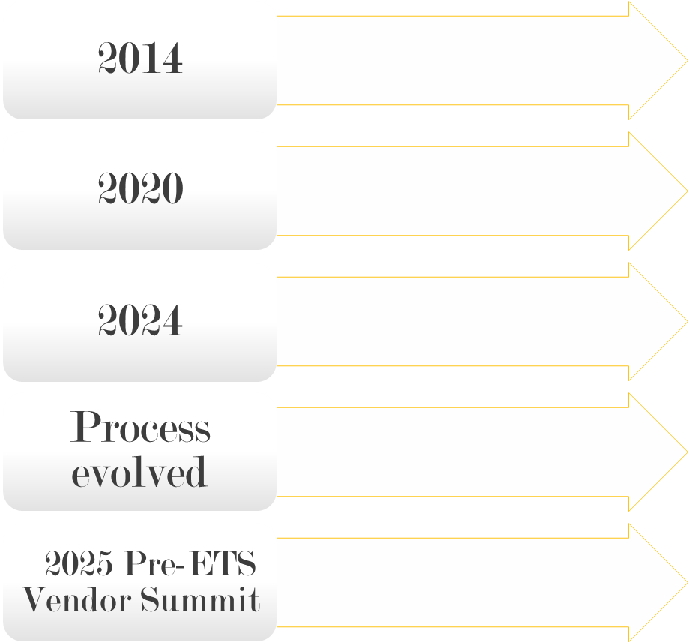
.

Slide 5
What does it mean to serve the Potentially Eligible?
In 2014, WIOA introduced the concept of Potentially Eligible. WIOA defines the potentially eligible as ‘students with disabilities’ who have not submitted an application to ACCES-VR and have not yet been formally determined eligible for VR services but are likely to qualify.
“Students with Disabilities”
Ages 14–22 (in New York).
Receiving special education or related services under the Individuals with Disabilities Education Act (IDEA), or are accommodated under Section 504 of the Rehabilitation Act.
Under WIOA, these ‘potentially eligible” SWDs can access only the five required Pre-ETS:
Job exploration counseling
Workplace readiness training
Work-based learning experiences
Counseling on postsecondary education
Instruction in self-advocacy
This early access helps prepare them for employment even before the full VR application process is complete.
Notes:
In 2014, WIOA introduced the concept of Potentially Eligible. WIOA defines the potentially eligible as ‘students with disabilities’ who have not submitted an application to ACCES-VR and have not yet been formally determined eligible for VR services but are likely to qualify.
“Students with Disabilities”
Ages of 14–22 (in New York).
Receiving special education or related services under the Individuals with Disabilities Education Act (IDEA), or are accommodated under Section 504 of the Rehabilitation Act.
Under WIOA, these ‘potentially eligible” SWDs can access only the five required Pre-ETS:
Job exploration counseling
Workplace readiness training
Work-based learning experiences
Counseling on postsecondary education
Instruction in self-advocacy
This early access helps prepare them for employment even before the full VR application process is complete.
PE students tend to be younger youth; although it doesn’t have to be. They can receive PE Pre-ETS until they turn 23.
After a SWD receives Pre-ETS through PE, they are encouraged to submit a VR application so that they can have access to the full array of VR services. Services that most of your agencies provide.

Slide 6
..
The Vendor Initiates the PE Process
Being approved to serve the Potentially Eligible (PE) allows vendors to provide Pre-ETS to students with disabilities (SWDs) before they apply to ACCES-VR.
These students do not have an open VR case—no VRC is assigned at this stage.
It allows vendors and VR to engage with students early, without waiting for formal eligibility determination, speeding up service delivery and outcomes
While there is a VR staff member approving each phase of the process to create a partnership, the vendor:
Identifies a Student with a Disability (SWD)
Recommends which Pre-ETS the student needs
Requests an authorization from ACCES-VR
Begins services upon approval of AV
Vendors initiate the process from outreach to service delivery—empowering early intervention and progress.
Notes:
READ SLIDE

Slide 7
Taking a Proactive and Leading Role
🔑 Vendors Are the First Point of Contact for PE
Potentially eligible students don’t need to have an active VR case to be approved by ACCES-VR for PE services
Schools, parents, or community organizations often reach out directly to vendors who are known to provide these services to PE students.
This allows vendors to identify the students to be served by referring them to ACCES-VR
🔑 Vendors Influence the Referral Pipeline
A vendor that provides quality Pre-ETS to potentially eligible students often becomes a trusted partner to schools and families.
This reputation can lead to increased referrals—including when students later apply for full VR services
Notes:
Read slide

Slide 8
How is PE Different than VR Eligible ?
The Vendor works with the School District to identify individuals who would benefit from the services.
The student/ legal guardian completes a PE Pre-ETS referral form.
The Vendor ensures the referral form is complete.
The vendor collects disability documentation and submits it with the referral and the request for services through the to ACCES-VR via the vendor portal.
Notes:
Read slide
PE Pre-ETS services are provided by a vendor only after ACCES-VR approves the referral of the student and issues an authorization to the vendor. Sufficient lead time is needed for this process in order to have enough time to review, approve and issue authorizations.
The curricula and syllabi you use for guiding your service provision is the same for both programs.
The Pre-Employment Transition Services that you provide are the same for Students with Disabilities with both regular VR cases and Potentially Eligible cases.
You can have the same staff providing the services in both programs.

Slide 9
The Potentially Eligible Process
Outreach to schools and potential referral sources
Schools and other potential referral sources identify SWD.
Vendor identifies what Pre-ETS are needed.
Vendor submits referral and authorization request
Notes:
Let’s talk about what the PE process look like from a practical perspective
Vendors conduct outreach to schools and other potential referral sources to build connections​, and we are going to talk more to places you can reach out to later on in the presentation. Developing relationships with schools/referring agencies is key. They will send SWDs your way.
Schools identify SWD who they feel would benefit from PE services ​
Schools and other potential referral sources assist SWD in applying for PE services with a specific vendor​
You will need to confirm they meet the definition of SWD, get the documentation (such as the IEP or 504 plan) and have the PE intake/consent form completed.
The vendor, along with referral partner identifies what Pre-ETS services are needed by the student​
You then submit a referral to ACCES-VR (via the AWARE vendor portal) for that SWD (attaching the documentation as well as the PE intake/consent form) and include the service(s) request.

Slide 10
PE Process Continued…
The SVRC TAYS reviews the referral and authorization request for completeness and appropriateness
The SVRC TAYS may follow up with the vendor with specific questions prior to approving the referral
Once the referral is approved, the SVRC TAYS creates a PE case for the SWD, reviews referral note, which specifies Pre-ETS requested, and creates an authorization for Pre-ETS
Notes:
The SVRC TAYS assigned to vendor's territory reviews the referral and authorization request for completeness and appropriateness
The SVRC TAYS may follow up with the vendor with specific questions prior to approving the referral
Once the referral is approved, the SVRC TAYS creates a PE case for the SWD, reviews referral note, which specifies Pre-ETS requested, and creates an authorization for Pre-ETS
***PE vendors can only provide services after having received an authorization ****

Slide 11
PE Process Continued.
The vendor delivers the Pre-ETS service using their pre-approved curriculum
The vendor submits a CRS report form specific for Pre-ETS completed, which is reviewed and approved by the SVRC TAYS for payment
Notes:
The vendor delivers the Pre-ETS service using their pre-approved curriculum
The vendor submits a CRS report form specific for Pre-ETS completed, which is reviewed and approved by the SVRC TAYS for payment

Slide 12
Building a successful PE program starts with developing PE Materials / Outreach
Notes:
PE vendors are responsible for developing their PE Pre-ETS referral sources.
The provision of Pre-ETS involves the collaboration of vendors, schools/referring agencies, and VR staff.
Developing effective partnerships with school personnel and/or other referral sources as well as gaining an understanding of how best to access the school environment will be key when working with students in high school. Please also consider non-traditional referral sources. For example, juvenile justice programs, home schooled students, trade school students. You can even reach out to your local colleges.

Slide 13
Vendor Outreach and Application Forms
Vendors can directly connect with high schools, colleges, etc., to identify possible students to serve.
The more outreach and relationships vendors develop, the steadier the flow of customers the vendor can provide PE Pre-ETS to.
Any outreach materials promoting the vendors PE services need to be submitted to their SVRC TAYS and vetted by Central Office Staff
Outreach materials can include flyers, PowerPoint productions, or other promotional tools
The PE application form is developed by the vendor for their agency is also vetted by Central Office and approved prior to use
Notes:
Read slide.

Slide 14
You create your PE application/referral form
Be sure your application form contains the following:
Student name, age, social security number, address, email, phone number
A release of information form for permitting communication with vendor, VR Staff, and the referral agency
Is signed by the parent (or student, age 18 or older)
Your referral packet should include the application, release form, and:
Documentation of disability (letter from medical provider, IEP, 504 plan, etc.)
Proof of student status (current IEP/504, report card, letter from school)
Notes:
Be sure your application form contains the following​
Student name, age, Social Security Number, and contact information​
A Release of Information form permitting communication with Vendor, VR staff and the referral agency

Slide 15
How Can I develop a Relationship with a School to Get SWDs Identified?
ACCES-VR
OSE Community Map
School relationship
Family and Community Engagement Center
Transition Consortium Meetings
Notes:
Building relationships with schools is KEY to successfully serving the PE.
They are your pipeline to customers.
Reaching out to SVRC TAYS in your region is an excellent way to begin the process of reaching out to school districts to develop a relationship. SVRC TAYS maintain a Liaison Contact list for each school district in their region. Another way to develop relationship with a school is to participate in location Transition Consortium meetings within your region. The local Family and Community Engagement Center (FACE) is another way to connect with school districts within your region.
Although schools are the primary referral source, vendors may also develop relationships with other agencies, such as Mental Health providers, who can facilitate referrals.
We have a list of all schools in New York who have not been connected to a PE Pre-ETS Vendor and we can help make that connection.

Slide 16
What can PE Pre-ETS service delivery look like?
Virtual
Weekends, evenings, school holiday breaks, summers
Groups (as long as it’s individualized)
At the school during a free period
Vendors should coordinate with schools, families and students to determine availability.
Notes:
Read slide

Slide 17
With PE, the sky is the limit:
OSEA merger
Pre-ETS statewide implementation team
Pre-ETS on the IEP
Schools will need to develop relationships with Vendors
We have around 800 schools in the state who are not currently connected with a PE vendor.
If you’d like to be connected to a school, contact your local SVRC TAYS.
Notes:
In the Fall of 2024, New York State’s Office of Special Education (OSE) and Adult Career and Continuing Education Services (ACCES) merged to create a newly interconnected structure OSEA: the office of special education and access.
Under the leadership of Deputy Ceylane Meyers-Ruff, this integration highlights a commitment to serving students with disabilities more effectively.
Under OSEA, a statewide “Pre-ETS Implementation Team” was formed with members from ACCES-VR, OSE and CTE. Their goal is to build relationships between Schools, VR and Pre-ETS vendors to expand the delivery of Pre-ETS across the state and support the use of Pre-ETS as a coordinated supplement to the transition services provided by school districts under IDEA.
Before the end of this year, high schools will be directed to start putting Pre-ETS on all student’s IEPs. These students will likely be served through PE.
Schools will be looking to develop relationships with vendors so that their students can benefit from Pre-ETS.

Slide 18
The Role of the SVRC TAYS in Coordinating PE Services
The SVRC TAYS is your primary point of contact within ACCES-VR for PE services.
The SVRC TAYS will review each referral for PE services and may have questions or concerns to be addressed prior to authorization
If you would like to modify your curriculum for a special event you need to communicate with your SVRC TAYS and submit the curriculum in advance for approval.
The SVRC TAYS reviews and rates reports
Notes:
The SVRC TAYS is your primary point of contact within ACCES-VR for PE services
The SVRC TAYS will review each referral for PE services and may have questions or concerns to be addressed prior to authorization
Vendors should only use their pre-approved curriculum in PE service delivery.
Vendors should only use their pre-approved curriculum in PE service delivery. If you’d like to update your curriculum (even if it’s just for a special event), you must submit it to ACCES-VR for approval first.
The SVRC TAYS reviews and rates reports

Slide 19
Your SVRC TAYS can help !!!
If you are having difficulty connecting with schools for outreach
Assisting multiple vendors in navigating relationships with schools in the same geographic region
Contact your SVRC TAYS if you would like to know whether a specific activity constitutes Pre-ETS.
Developing a coordinated process to refer PE students to ACCES-VR
Notes:
Read slide.
SVRC TAYS rating of Pre-ETS reports (not sure this is necessary. Should this be omitted and the final “bullet” be that the TAYS can help with students transitioning to full vr?)
Transition from PE to VR. Vendors assist with applying to VR.

Slide 20
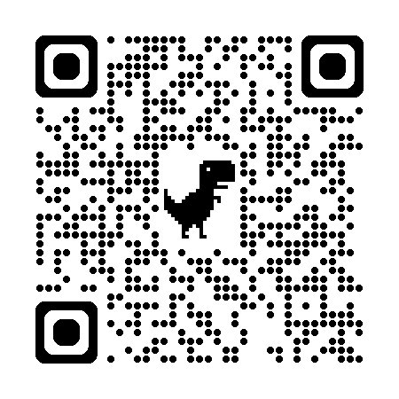
How to contact SVRC TAYS in your region?
Adult Career and Continuing Education Services | NYS Education Department
Student and Youth Transition Services | Adult Career and Continuing Education Services | NYS Education Department
Notes:
How to contact SVRC TAYS in your region.
As list of SVRC TAYS for each district office is located on the ACCES-VR website. The slide illustrates the pathway to locate the Student and Youth Transition Services Statewide Team.
You can also scan the QR code on the screen, which will take you to the Student and Youth Transition Services Statewide Team located on the ACCES-VR website.

Slide 21
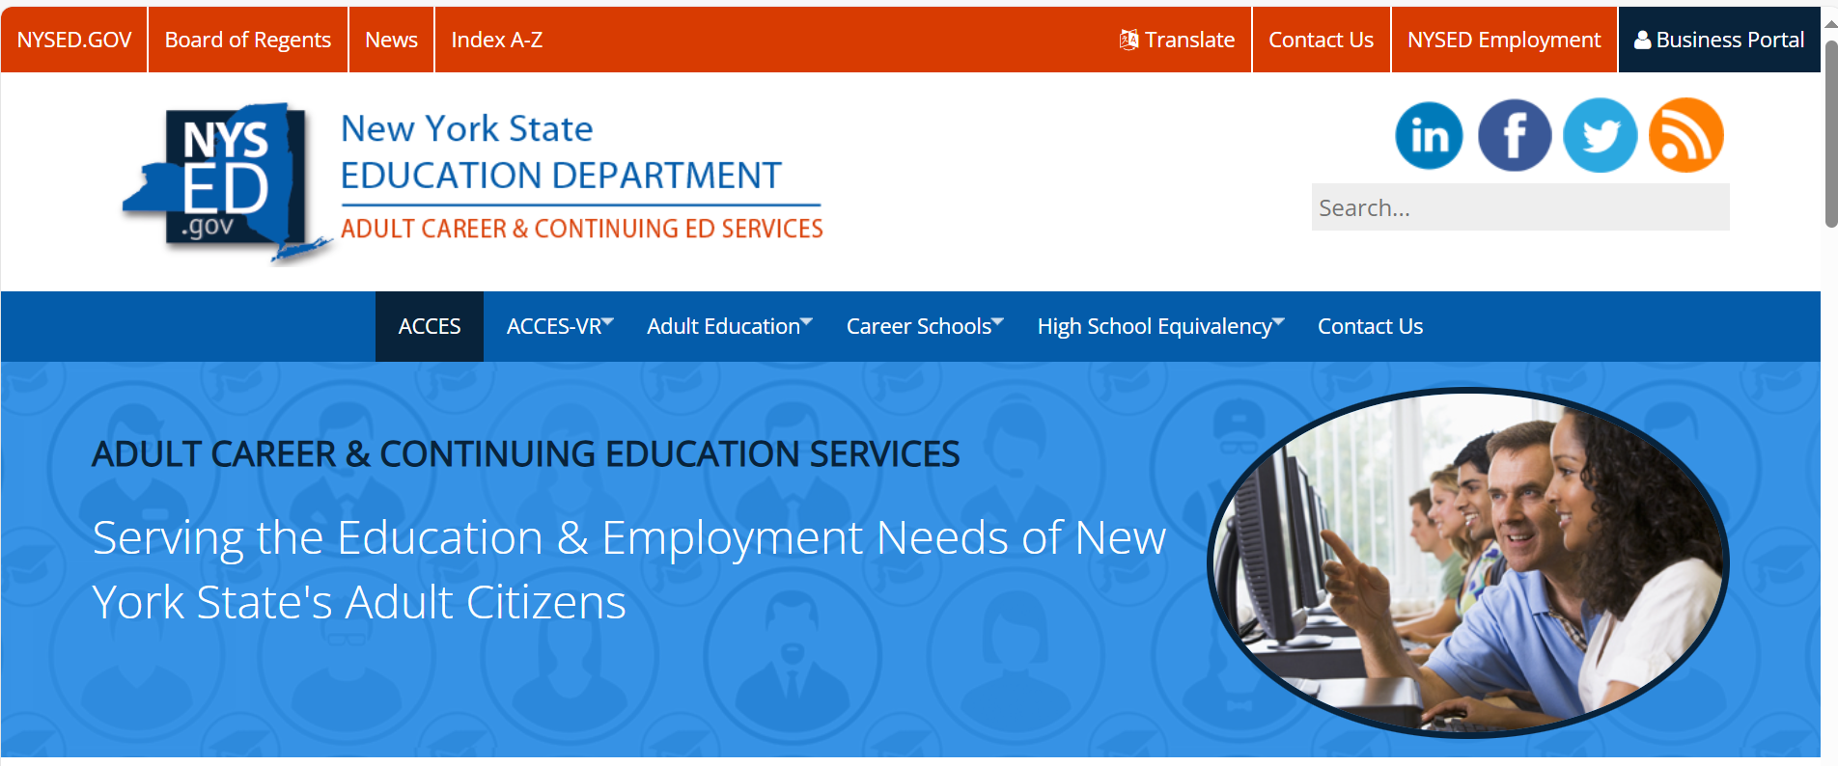
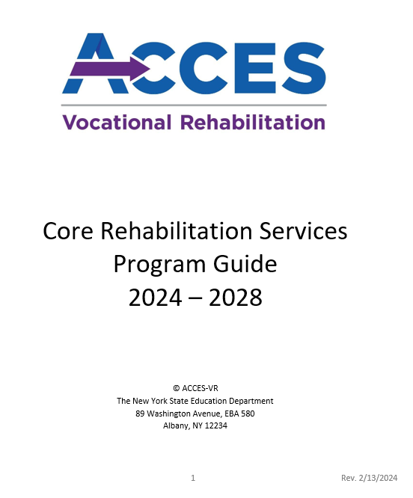
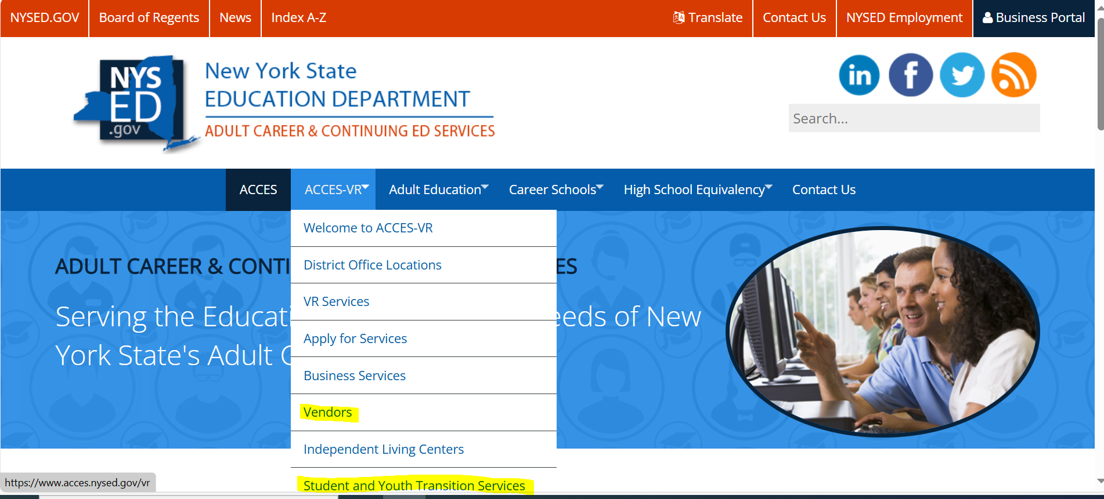
Resources
Adult Career and Continuing Education Services | NYS Education Department
Notes:
We recommend viewing the following resource located on our ACCES-VR website:
ACCES-VR website
CRS Guide (add guide cover page)
Please note: We strongly recommend that you do not download or print a copy, and instead always access the CRS Program Guide from this link. This guide may have been updated and we want to make sure you are always accessing the most up-to-date version.)

Slide 22
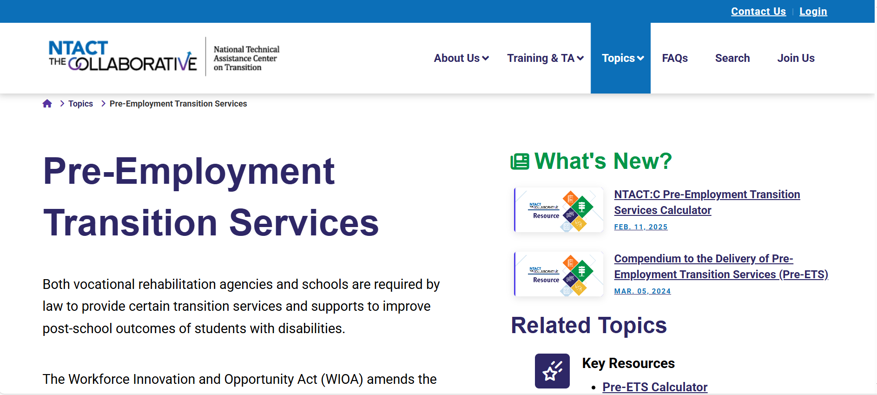
Resources (continued)
NTACT:C | National Technical Assistance Center on Transition
Notes:
An additional resource is the National Technical Assistance Center on Transition, NTACT.
The web address is listed on the slide.

Slide 23
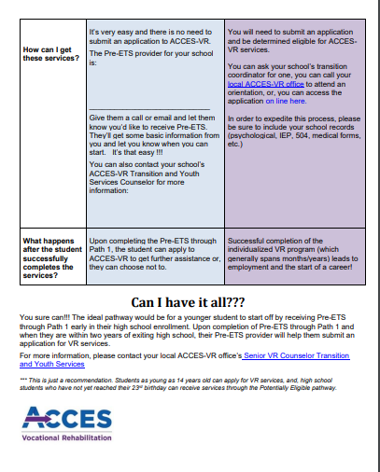
Pathway Flyer
https://www.acces.nysed.gov/sites/acces/files/vr/pe-vs-vr-flyer.pdf
Notes:
We have a great flyer that we’ve created to show the differences between PE and VR. It’s available on our SharePoint page (as a tool for us to print and use) and posted on our website so the public can access it. If you don’t have it, please ask your TAYS. The flyer can be given to families, school staff, etc. to help them understand the differences and what might be best for their student. Potentially eligible pathway is identified as pathway one on the flyer. Pathway 2 is the pathway for students with disabilities who have applied to and have been determined eligible for vocational rehabilitation services.

Slide 24
Pre-ETS Brochure
https://www.acces.nysed.gov/sites/acces/files/vr/pe-vs-vr-flyer.pdf
Notes:
Pre-ETS Brochure is another resource to use when recruiting students with disabilities to participate in Pre-ETS.

Slide 25
Q and A

Slide 26
…
Notes:
Thank you for your participation in How Do Potentially Eligible (PE) Services Differ From VR-Eligible Services?
We appreciate your input and will send out responses placed in the Parking Lot.

