Slide 1
Re-Imagining Student and Youth Engagement: Awareness to Action
NY Vendor Summit 2025

Slide 2
Disclaimer
"The contents of this presentation were developed under grants H326E200003 and H264J200002 from the Department of Education. However, these contents do not necessarily represent the policy of the Department of Education, and you should not assume endorsement by the Federal Government."

Slide 3
Learning Objectives
At the end of this training, participants will be able to:
Explain why shifting from being the “adult” to being an active adult ally supports student and youth engagement and meaningful involvement.
Explain a process that can help adults recognize and shift from being the adult to being an active adult ally.
List strategies to support continuous engagement of students and youth

Slide 4
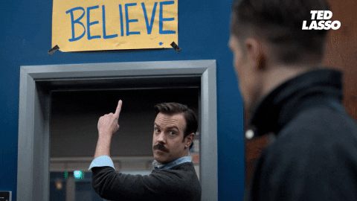
Bio: Melissa Diehl – Pronouns: She/Her/Hers
Cake Connoisseur, Ted Lasso Enthusiast, & Elephant Enthusiast
Professional Background
Vocational Rehabilitation (VR) Counselor
VR Statewide Training Coordinator
RSA Liaison
Technical Assistance – TACE, WINTAC, NTACT:C
Education
Masters Degree – Rehabilitation Counseling
Doctoral Candidate – Human and Organizational Learning
Areas of Expertise
Leadership and Professional Identity Construction
Training and Development
Federal Policy Oversight and Implementation

Slide 5
Rapid Engagement of Students and Youth
Awareness
Analysis
Action

Slide 6
Awareness

Slide 7
Awareness: Let’s Play a Game
“Because I said so”
“As long as you’re under my roof, you will live by my rules.”
“I’m not asking, I’m telling”
“When you pay the bills, you can do whatever you want”
“Do as I say, not as I do”

Slide 8
Awareness: Surfacing Assumptions through Critical Self-Reflection
Reflect on your own experience of adolescence and young adulthood.
Think about the statements we just walked through – how many of those statements did you hear while you were a teenager (how many fingers could you put down)?
How many of you were raised in an era where social norms dictated that the adult(s) were always correct (i.e., respect your elders) even when or if the adult(s) were not correct?
Think about our major American institutions and their cultures (i.e., Schools, Social Services etc.), what are the underlying assumptions about adults and youth?
Notes:
How do these ideas

Slide 9
The Human Brain & Mental Models
Information Processing
Consciously aware of only a very small portion of the millions of bits of data we process every second, so our brain creates cognitive shortcuts to help us process.
Subconscious Mind
Categorizes
Creates Associations
Fills in the Gaps
Source: Institute for New Economic Thinking; HAAS Institute for a Fair and Inclusive Society; and Powell, J. (2016). Healing Otherness: Neuroscience Bias and Messaging (see Other & Belonging Institute)

Slide 10
Awareness: Recognizing and Unpacking Our Mental Models (Underlying Assumptions)
Mental Models are the frames we employ to help us make sense of and navigate the world. Largely based on our cultural and social experiences and interactions, they shape our:
reasoning
what we think
how we understand
how we simplify complexity
In essence, mental models, often play a big role in what and how we “know” something, however, mental models can also mistake experience for objective fact. In other words, mental models also contribute to underlying assumptions.
Source: Institute for New Economic Thinking; HAAS Institute for a Fair and Inclusive Society; and Powell, J. (2016). Healing Otherness: Neuroscience Bias and Messaging (see https://belonging.berkeley.edu/sites/default/files/healing_otherness_ppt.pdf )
Notes:
Many of us who are current VR counselors or other associated professionals were raised in an era where social norms dictated that the adults were always correct (i.e., respect your elders) even when or if they were not correct.

Slide 11
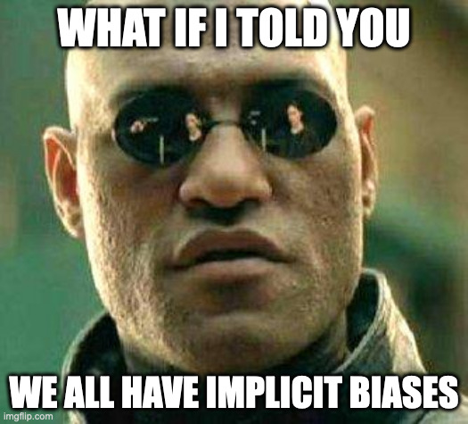
Implicit Bias
Implicit bias, like other forms of bias, is an inclination or preference towards or away from someone/something but it occurs automatically and unintentionally and is often shaped by experiences and learned associations
Unconscious Bias is the result of our limited cognitive capacity
It is our unintentional preferences formed by our socialization and experiences, including exposure to (social) media
There are an overwhelming number of studies that have shown the significant impact unconscious bias can have on human cognitive processes

Slide 12
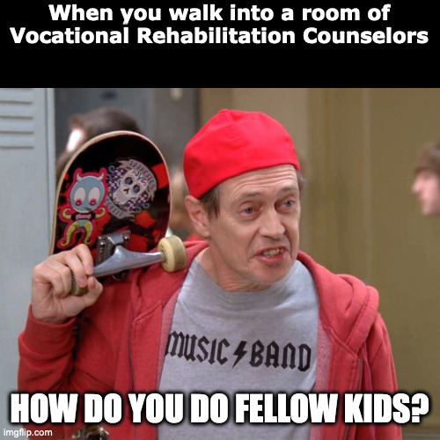
Early Social Identity Research - 1
Henri Tajfel, the founder of social identity theory, defined social identity as a person’s sense or understanding of who they are in relation to group membership.
Group membership is our connection to the social world and helps individuals develop their social identities – the groups people belong to often give persons a sense of pride and self-esteem.
Social Identities not only describe who people are, they can also prescribe people’s behavior based on those social expectations associated with the group.
McLeod, S. A. (2019, October 24). Social identity theory. Simply Psychology. https://www.simplypsychology.org/social-identity-theory.html

Slide 13
Early Social Identity Research - 2
Tajfel’s research also demonstrated that humans, as part of their typical cognitive process, categorize things and in doing so tend to over-exaggerate the differences between groups and similarities within groups. These groups are then referred to as the “in group” and the “out group”.
This idea of the human cognitive tendency to categorize things coupled with social identity theory’s assertion that humans are prone to over exaggerate differences and similarities helps explain how identity is socially constructed and how implicit bias occurs.
McLeod, S. A. (2019, October 24). Social identity theory. Simply Psychology. https://www.simplypsychology.org/social-identity-theory.html

Slide 14
Awareness: Common Examples of Embodied Social Identities
Macro Level
Meso/Micro Level
Race
Ethnicity
Gender Identity
Sexual Orientation
Dis/Ability
Class/Socioeconomic Status
Education
Religion/Faith
Identity by Profession
VR Counselor, Lawyer, Student, Teacher, Plumber, Pastor/Priest etc.
Identity via Community
City Council Member, School Board Member, Pole Worker, etc.
Identity via Family
Grandparent, Parent, Sibling, Kid, etc.
Identity by Interest
Baker, Reader, Crossfit, Gardner, DND
Identity by Cause
Cancer Survivor, Climate Change, Social Justice Issues

Slide 15
How to be an Active Adult Ally

Slide 16
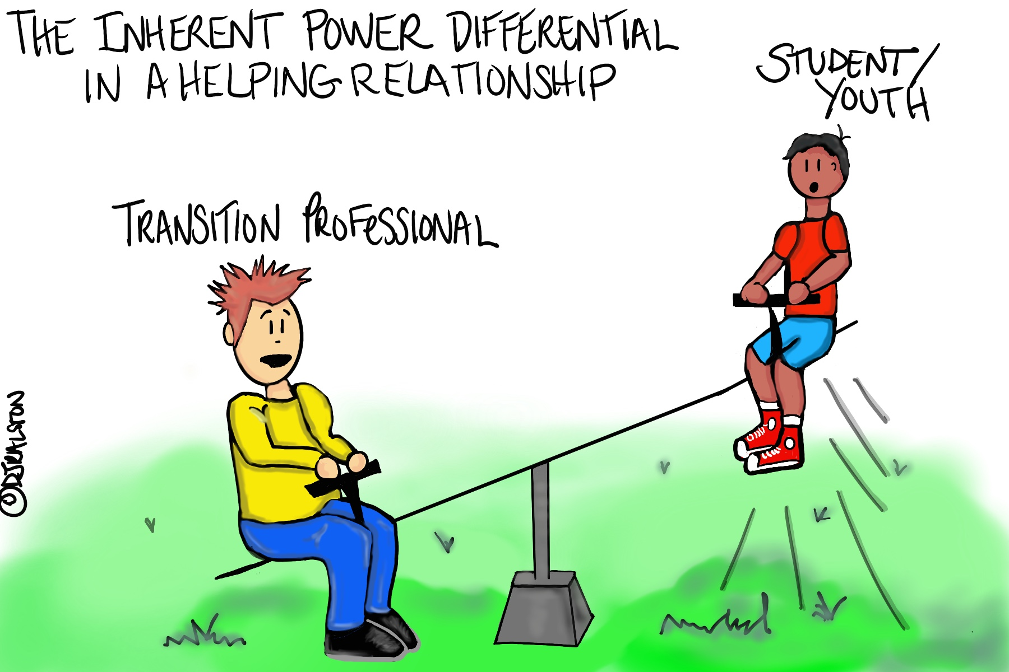
Awareness: Recognize Power Dynamics
Within the helping-relationship (such as that of a Transition Professional and a Student or Youth) there is always an inherent power differential because one party needs assistance which leaves them with less power than the person helping.
In Transition helping-relationships that inherent power differential is typically compounded by cultural and societal norms associated with age difference.
What other power differential often exists (hint: Abled vs. Disabled)
Notes:
Gatekeeping

Slide 17
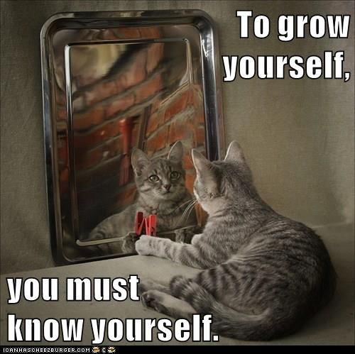
Action: Engage in Critical Reflection – 1
What does this mean?
Critical self-reflection is the process of analyzing and evaluating one’s experiences, beliefs, and actions to develop a deeper understanding of oneself and the world.
Everyone has implicit biases, engaging in critical self-reflection helps mitigate bias, promote, learning, growth and professional development.

Slide 18
Action: Engage in Critical Reflection – 2
Critical Reflection Key Characteristics
Self-awareness: Critical reflection involves a high level of self-awareness, as individuals examine their own thoughts, feelings, and behaviors.
Openness to feedback: Critical reflection requires individuals to be open to feedback from others and willing to consider alternative viewpoints.
Analytical thinking: Critical reflection involves a process of analyzing and evaluating one's own experiences, beliefs, and actions.
Action-oriented: Critical reflection is not just about thinking, but also about taking action to improve oneself and the world.
Notes:
Create a reflective space
Set aside time
Review your experiences
Identify patterns
Consider alternative perspectives
Set goals for growth
Seek support

Slide 19
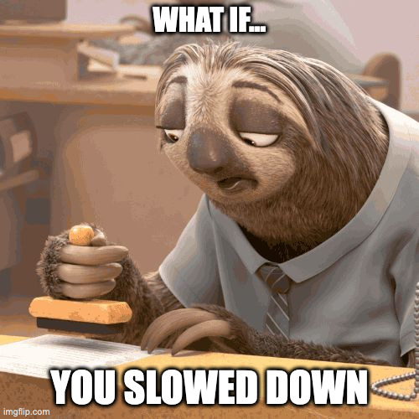
Action: Engage in Critical Reflection – 4
Consciously engage in critical self-reflection when working with a student/youth – Ask Yourself:
What and who are controlling the narrative in this situation?
What do you know about the student/youth you are working with? How do you know that? Why is that knowledge valid? Are there other sources of knowledge that should be considered?
How is success being defined? Who is defining it?
Why is one course of action recommended and not another? Who benefits most from the course of action recommended?

Slide 20
Awareness: Shifting the Approach
According to our partners at the RAISE Center:
One of the key elements of youth engagement is creating a space where youth feel their actions and voice have value.
Part of creating that environment is making sure the adults supporting those youth change their mindset from being the adult “in charge” to an adult ally that works in partnership with the youth to achieve group goals or activities.

Slide 21
Awareness: Authentic Engagement
According to the RAISE Center:
Authentic youth engagement is present when young adults are provided opportunities to consistently participate in decision making, take ownership of work, initiate conversations and plans, and able to give feedback that impacts programs, services, and/or systems that serve them.

Slide 22
Analysis: Ladder of Student Involvement
Notes:
Ladder of Student Involvement in Schools:
8. Student/Adult Equity
7. Complex Student-Driven
6. Student/Adult Equality
5. Students Consulted
4. Students Informed
3. Tokenism
2. Decoration
Manipulation
Adapted by Adam Fletcher (2011) from work by Roger Hart, et al. (1994)

Slide 23
Analysis: Ladder of Student Involvement Defined
Ladder Rung | Defined
1. Student Manipulation | Compelled or forced to attend without regard to interest
2. Student Decoration | Simple presence of students is all that is required - their active involvement is not considered
3. Student Tokenism | Students are involved only to reinforce the perception they’re involved
4. Student Informed | Student input does not have to be implemented – meaning their input is not considered unless it actively aligns with what the adult has already determined to be the priority
5. Student Consulted | Students have limited authority and it is subject to adult approval
6. Student - Adult Equality | While this is a 50/50 split of authority, obligation and commitment it does not consider specific developmental needs and without recognition students may lose interest and become disengaged.
7. Completely Student-Driven | Adults take on only a passive role while students are then often perceived as less considerate and informed and absent of understanding of larger impact to the student community – validity also often questioned.
8. Student - Adult Equity | Full Equity with adults understood as a 40/60 or 20/80 split and requires a conscious commitment by all participants.
Ladder of Student Involvement adapted from Hart – Adam Fletcher (2011)

Slide 24
Analysis: Student/Youth Voice and Input
How does your agency gather input from youth and families about what they need?
Other Considerations when and where input can be solicited:
When services are offered
Where services are offered
From whom services are offered
What services are needed
How services are delivered
Innovative and flexible strategies
What supports do students and families need to stay engaged

Slide 25
Analysis: What does high quality engagement look like?
To ensure meaningful engagement all interaction should focus on the student and their goals
How quickly to do we make contact with students and families once referred for service?
How often do we engage with students once initial contact is made?
What methods of communication do we use?
Is there a plan for consistent and constant communication that is co-constructed with the student/youth?
What is the student/youth’s preference for modality?
What is the student/youth’s preference for frequency?

Slide 26
Action: Tips to Foster Engagement

Slide 27
Action: Suggestions from the RAISE Center:
Develop a Youth Friendly Culture
be flexible and creative in finding ways for youth to engage in services
Provide Information in Youth Friendly Ways
have meetings in accessible locations, both virtually and in person
ensure information is easy to read and understand
use appropriate language, don’t talk down to youth or use unfamiliar acronyms or complex jargon
Include Youth Voice at Every Level
get youth involved in making decisions and supporting their thoughts/ideas
Partner with Youth-Serving Organizations
Ask yourself questions such as: Where do youth in our community spend time, Who are the local experts we can learn from, What programs already exist that we can support, etc., and connect youth to these entities.
Build Relationships with Youth

Slide 28
Action: Suggestions from the RAISE Center (Cont.)
Have meetings outside of school hours.
Provide a webinar or call-in option with an adequate sound system.
Send meeting reminders in a preferred, accessible form of communication.
Have meetings in an accessible location: ADA compliant, with parking or near public transport.

Slide 29
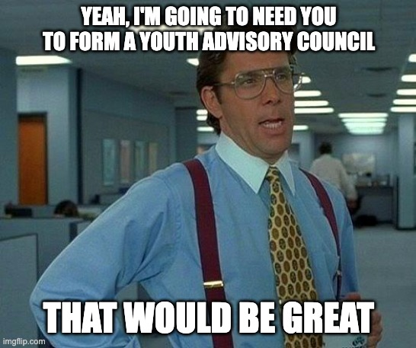
Action: “Nothing About Us Without Us” - Youth Advisory Council(s)
Gives youth an opportunity to develop their leadership skills
Centers Youth Voice
Nothing About Us Without Us
Youth Know What Youth will respond to and how to reach them (i.e. social media and other digital platforms).
Youth can gain access to other youth in ways that programs struggle to.
Notes:
Missy
Also Discuss Peer Mentoring...

Slide 30
Action: Peer Mentoring – A Tool for Engagement /Re-engagement
Provides exposure to new experiences and opportunities- builds self-advocacy, cultural strengths, values, pro-social behavior and empowerment
Peer mentoring can connect youth to others who share a common trait, such as an disability, or who had just traveled a path the mentee was about to go down, such as heading into freshman year at a new school.
Peer support is viewed as providing unique leverage for influencing change.
Promotes connectedness to school and school engagement or retention by increasing social support, social acceptance, connectedness to peers, teachers, and staff, and belonging at all school levels
Mentoring may look different than traditional one-on-one mentoring; may include family and community; group style; be part of an existing program (cultural or faith-based, or after school programs, Boys & Girls Clubs of America)
Notes:
Research shows “when young people have a say in what they are doing and when they feel they are a part of a team they are more likely to be interested in the plan and more likely to achieve the goals set forth by the team” peer coaching, peer leadership, and peer helping — often make use of socioecological approaches that postulate that young people may be motivated to positively
change or adapt their behavior and attitudes in relation to the social context around them and that their fellow peers might actually, in some cases, be better suited to influence their future thoughts and actions than adults. distinguishing factors that differentiate peer mentoring from other peer-led interventions:
• The first thing to note is the primacy of the mentoring relationship itself to the achievement of outcomes. While peers may be good at simply
teaching skills to other kids, or delivering key messages about topics like healthy behaviors,peer mentoring programs are different because the relationships formed between mentors
and younger participants are intentionally built and offer the context in which the benefits of the program are realized. A peer tutor may do a good job of building an academic skill for a
mentee, but a peer mentor may go well beyond that simple achievement by using the context of the relationship to help the mentee grow
developmentally, in addition to learning skills, and may be a more salient role model because of the proximity in age — older enough to be someone to look up to, but young enough to be relatable and a true friend. Additionally, by focusing on the relationship as the primary point of the program, these programs avoid becoming deficit-based or
focused solely on youth “problems.” Social inclusion, school connectedness,
leadership development, academic skills,
behavior modification, healthy lifestyles,
managing peer relationships

Slide 31
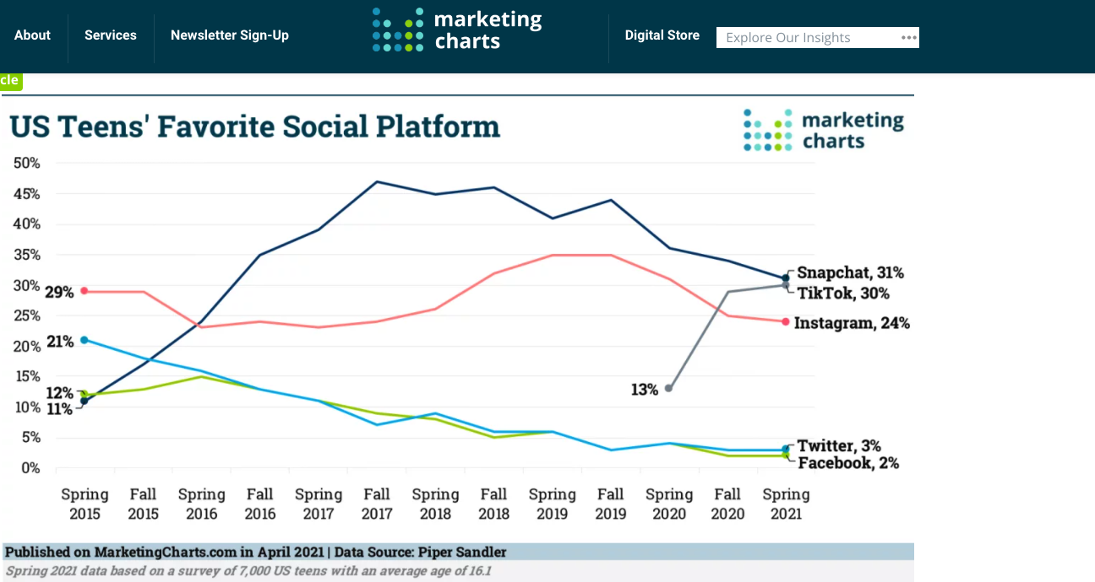
Action: Rethinking Technology
Notes:
DJ

Slide 32
Action: Rethinking Technology (Cont.)
Leverage your newly-established Youth Advisory Council to create and run accounts on popular platforms
Consider looking at youth/student Affinity Groups to learn more about the issues impacting/important to them.
Notes:
DJ

Slide 33
YETI Top Ten Tips for Student & Youth Engagement
https://www.youtube.com/watch?v=emswzQbv0sw

Slide 34
Action: YETI Top Ten Tips for Student/Youth Engagement
Build in time to recognize understand, and use, the student/youth perspective on your meeting agendas
Be open to student/youth’s ideas and feedback even if it is difficult to hear
Give students/youth tangible things to work on
Take a young person at their word
Respect boundaries set by young folks

Slide 35
Action: YETI Top Ten Tips for Student/Youth Engagement (Cont.)
Take time to teach students/youth the system(s) including providing lists of typical acronyms
Youth are EXPERTS on their own experiences
Take time to learn about what the young folks who are being invited in teams/spaces with adults are passionate about
Listen to and honor accommodation requests
Social interactions and discussions are important

Slide 36
References
Fletcher, A. Sound Out (2021) Adapated Ladder of Student Involvement (Hart, 1997)
Institute for New Economic Thinking; HAAS Institute for a Fair and Inclusive Society; and Powell, J. (2016). Healing Otherness: Neuroscience Bias and Messaging (see https://belonging.berkeley.edu/sites/default/files/healing_otherness_ppt.pdf)
Raise Parent Center (2022). Youth Engagement Toolkit Series

Slide 37
Find us: #transitionTA | transitionTA.org | ntact-collab@uncc.edu
The contents of this presentation were developed under a grant (H326E200003) from the Department of Education. However, those contents do not necessarily represent the policy of the Department of Education, and you should not assume endorsement by the Federal Government.
37

